Slide 1
Chapter 9: Artificial Intelligence and GIS

Slide 2
Learning outcomes
interpret, use, and design machine-readable ontologies to help increase the interoperability of spatial information;
represent qualitative spatial relationships, such as left and right, cardinal directions, and region relations, within automated reasoning systems;
apply the basic machine learning techniques that underpin many common spatial analyses; and
understand the principles and limitations of advanced machine learning techniques, such as artificial neural networks and deep learning.

Slide 3
Artificial intelligence
Artificial intelligence (AI) concerns the design and development of machines imbued with behaviors and abilities that might otherwise be regarded as requiring human intelligence
Two major branches of AI, both of which have a history of spatial applications dating back to the genesis of GIS:
Knowledge representation and reasoning (KR²): automated logical reasoning together with symbolic representations of knowledge
Machine learning (ML): automated learning from data

Slide 4
Section 9.1
Ontology engineering

Slide 5
Ontology engineering
The word “ontology” has two related but distinct senses:
Ontology (as a “mass noun”): the philosophical study and classification of what things exist
An ontology or ontologies (as a “count noun”): an explicit, unambiguous, and machine-readable specification of the meaningful and relevant entities and relationships in an application
Ontology engineering: the activity of designing and using computerized ontologies

Slide 6
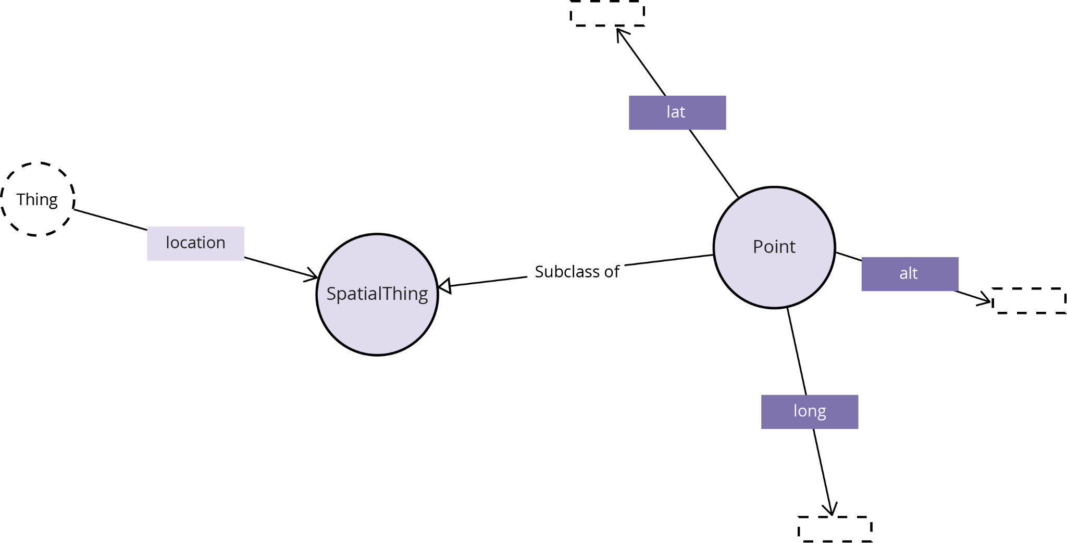
Example ontology
http://www.w3.org/2003/01/geo/wgs84_pos#SpatialThing

Slide 7
Representing data using ontologies
The Semantic Web consists of a collection of technologies to link data to rich, machine-readable ontologies representing the meaning of that data
Resources in the Semantic Web are uniquely identified using a URI (uniform resource identifiers)
Web URLs (uniform resource locators) are a familiar example of URIs commonly used to identify Semantic Web resources
The connections between resources in the Semantic Web are captured using triples: an atomic fact of the form:
subject predicate object

Slide 8
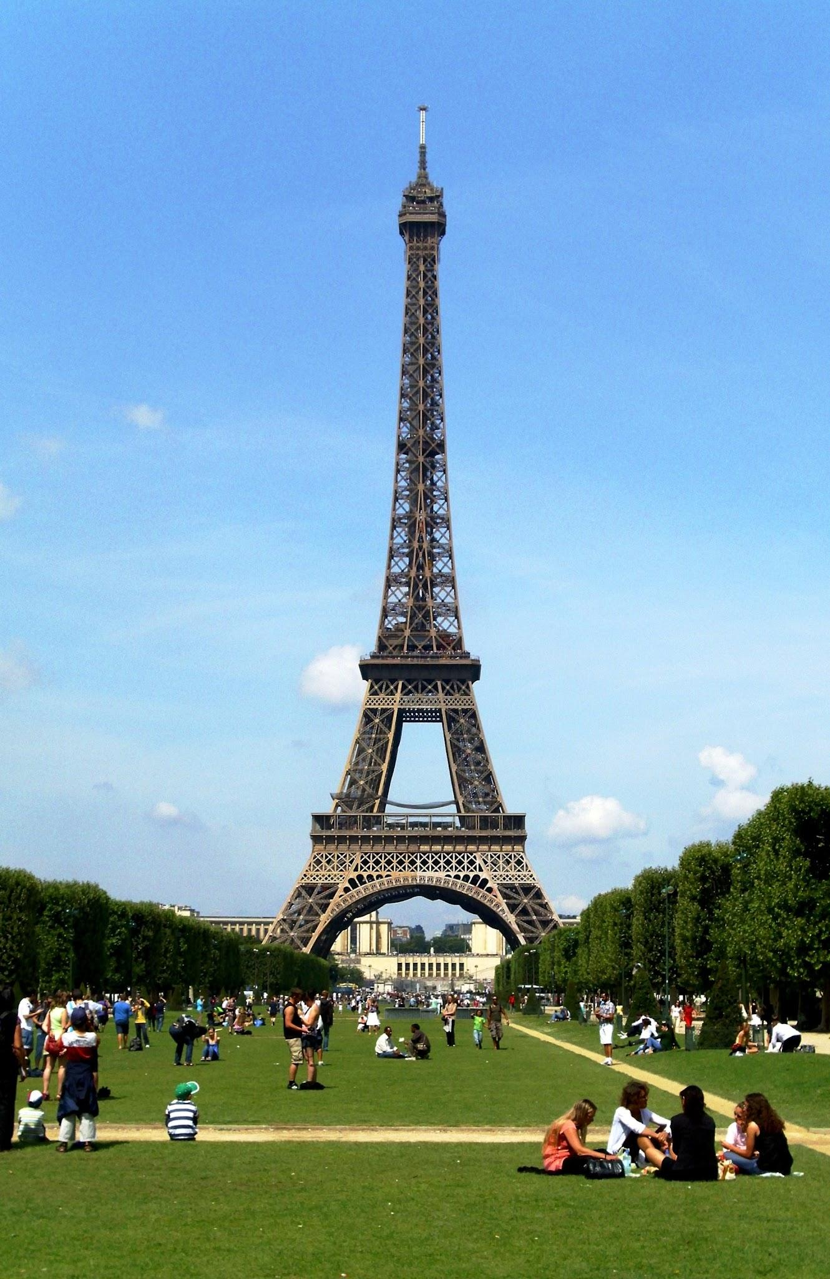
Subject predicate object
Representing the fact that “The Eiffel Tower is located in Paris”
“Eiffel Tower” (subject, “Tour Eiffel” in French)
“located in” (predicate)
“Paris” (object)

Slide 9
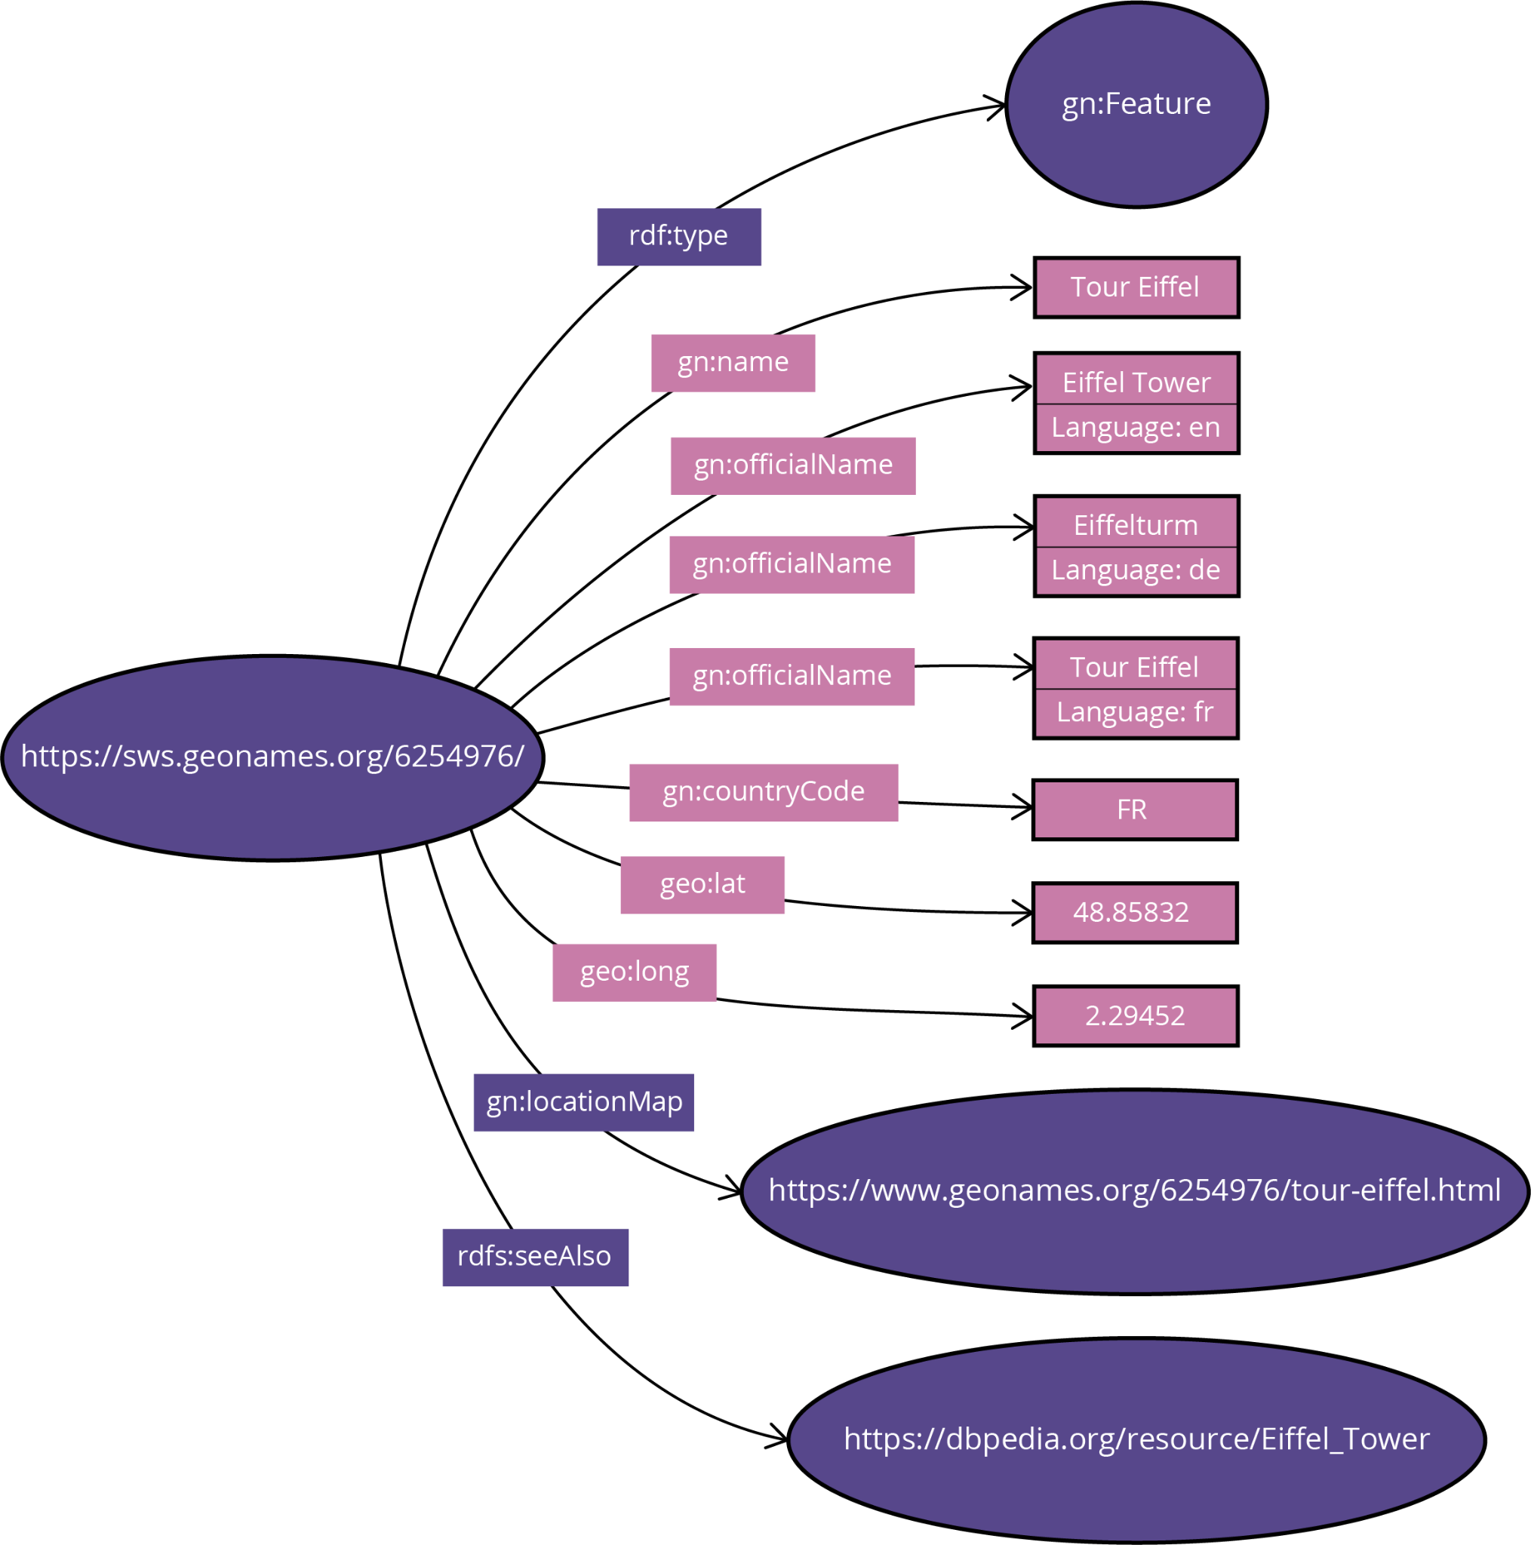
Knowledge graph

Slide 10
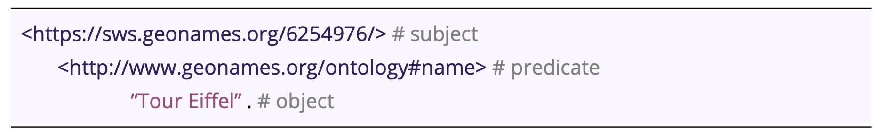
Turtle

Slide 11
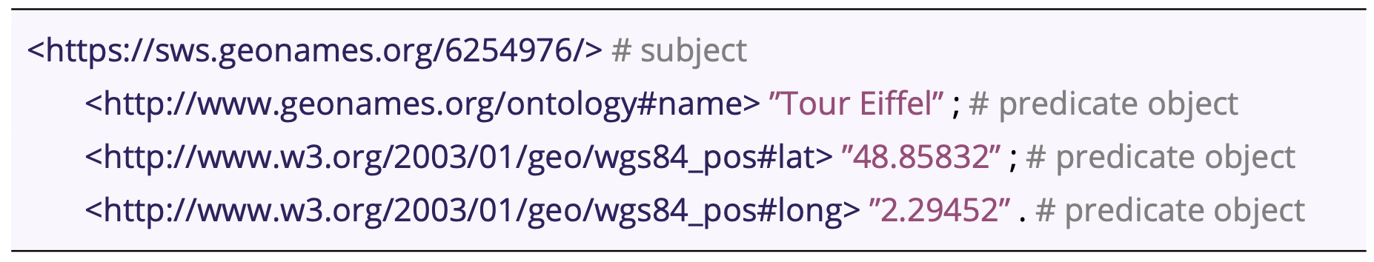
Turtle

Slide 12
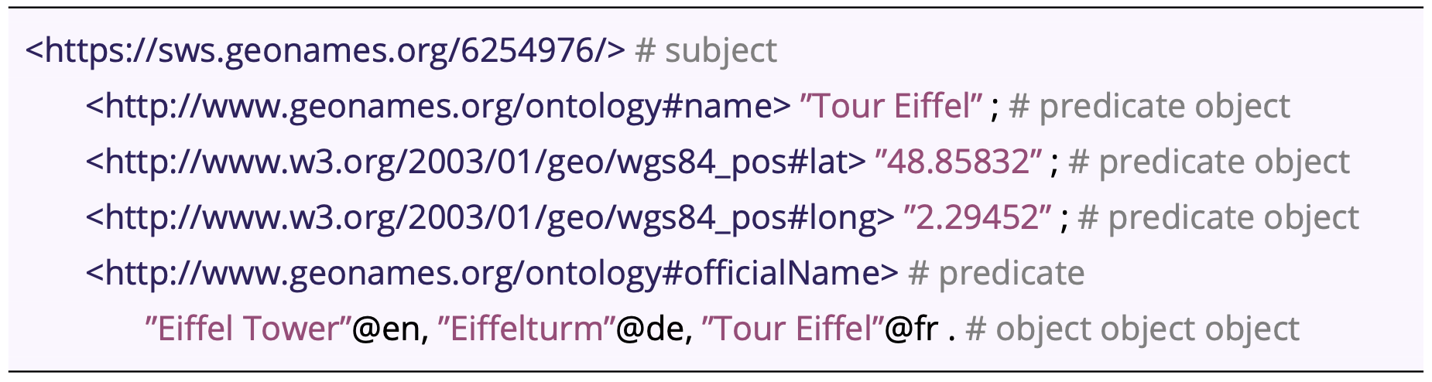
Turtle

Slide 13
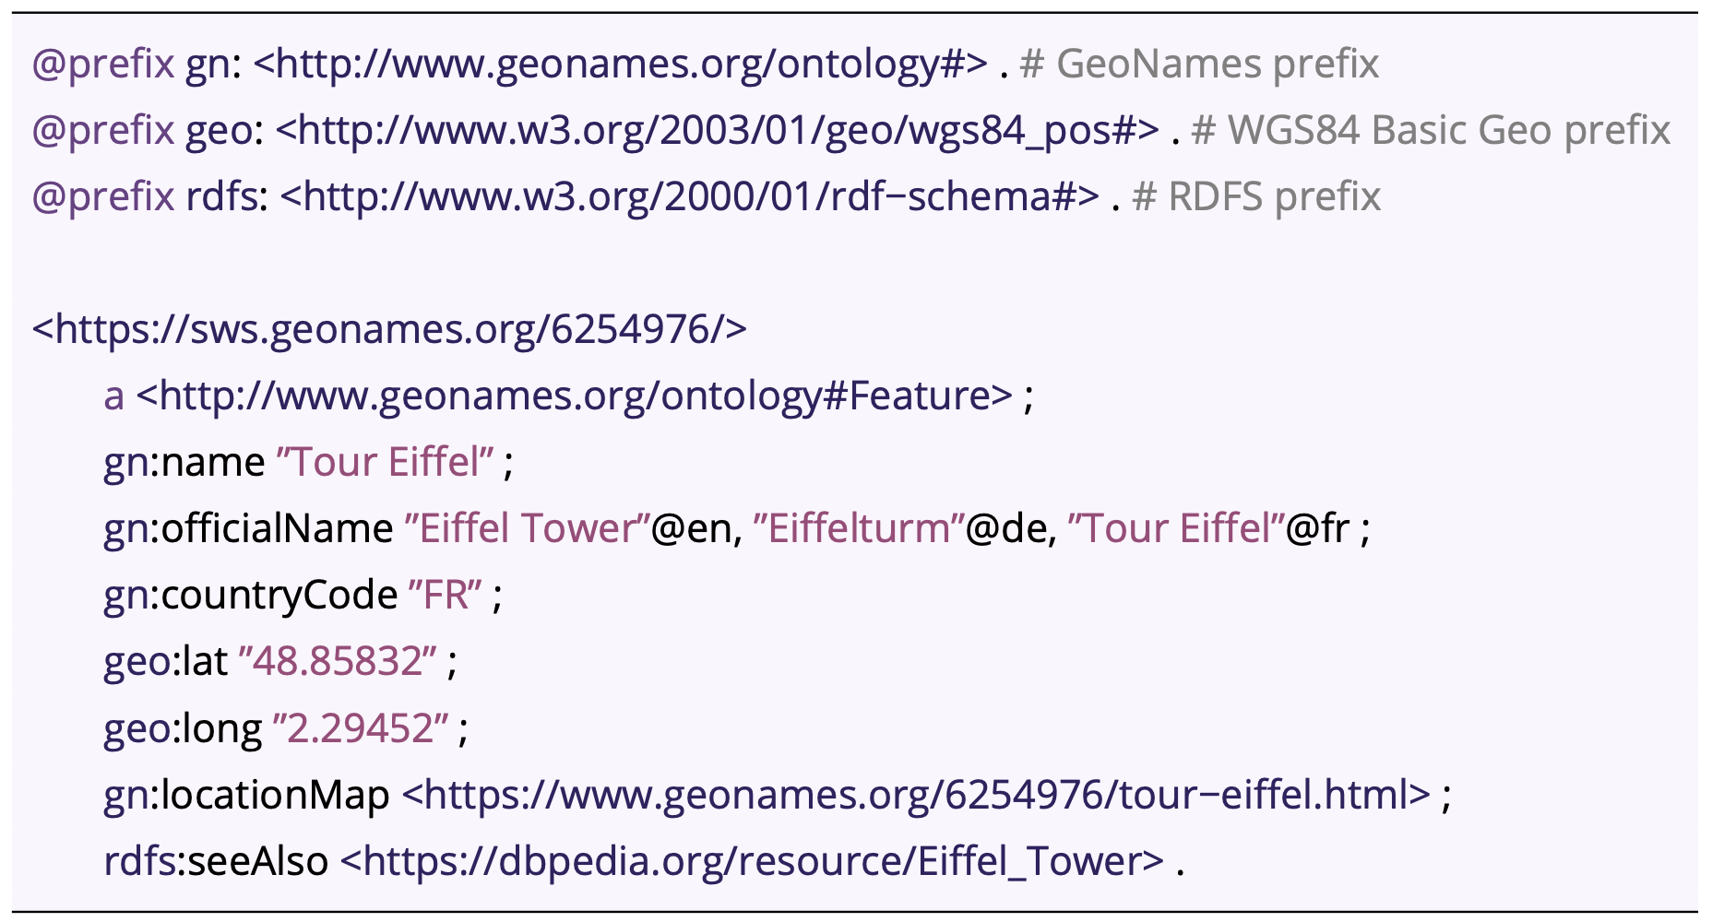
Turtle

Slide 14
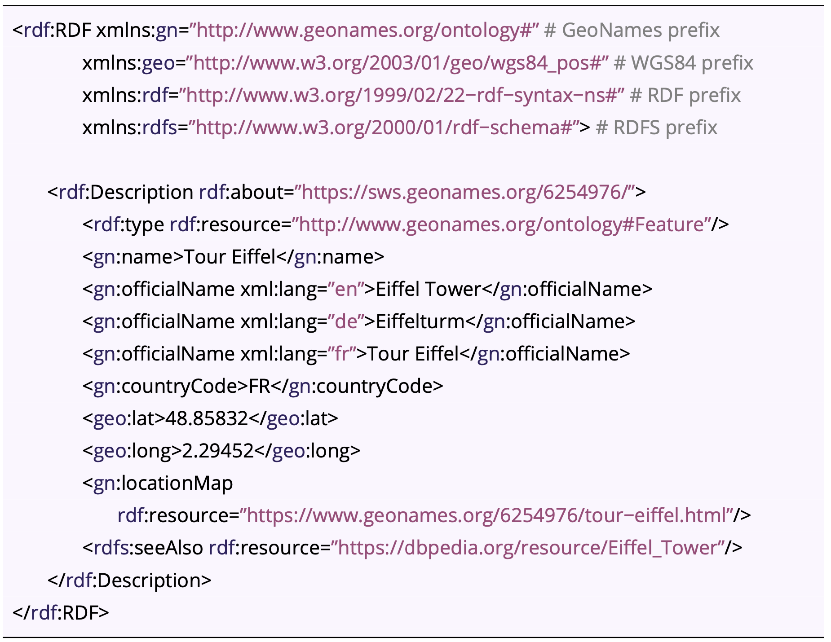
RDF/XML

Slide 15
Querying ontologies
A triple store is a database specifically designed to store and retrieve only RDF subject-predicate-object triples.
Like relational databases, triple stores enjoy a standard query language: SPARQL
Echoing SQL, SPARQL queries are constructed around SELECT ... WHERE statements:
The SELECT clause is followed by one or more variables that will appear in the query results
The WHERE clause then lists patterns to match against the stored graph

Slide 16
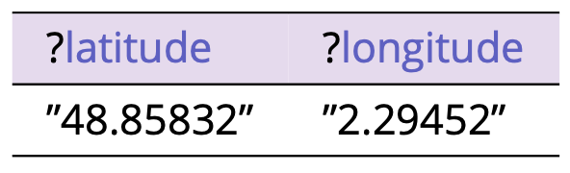
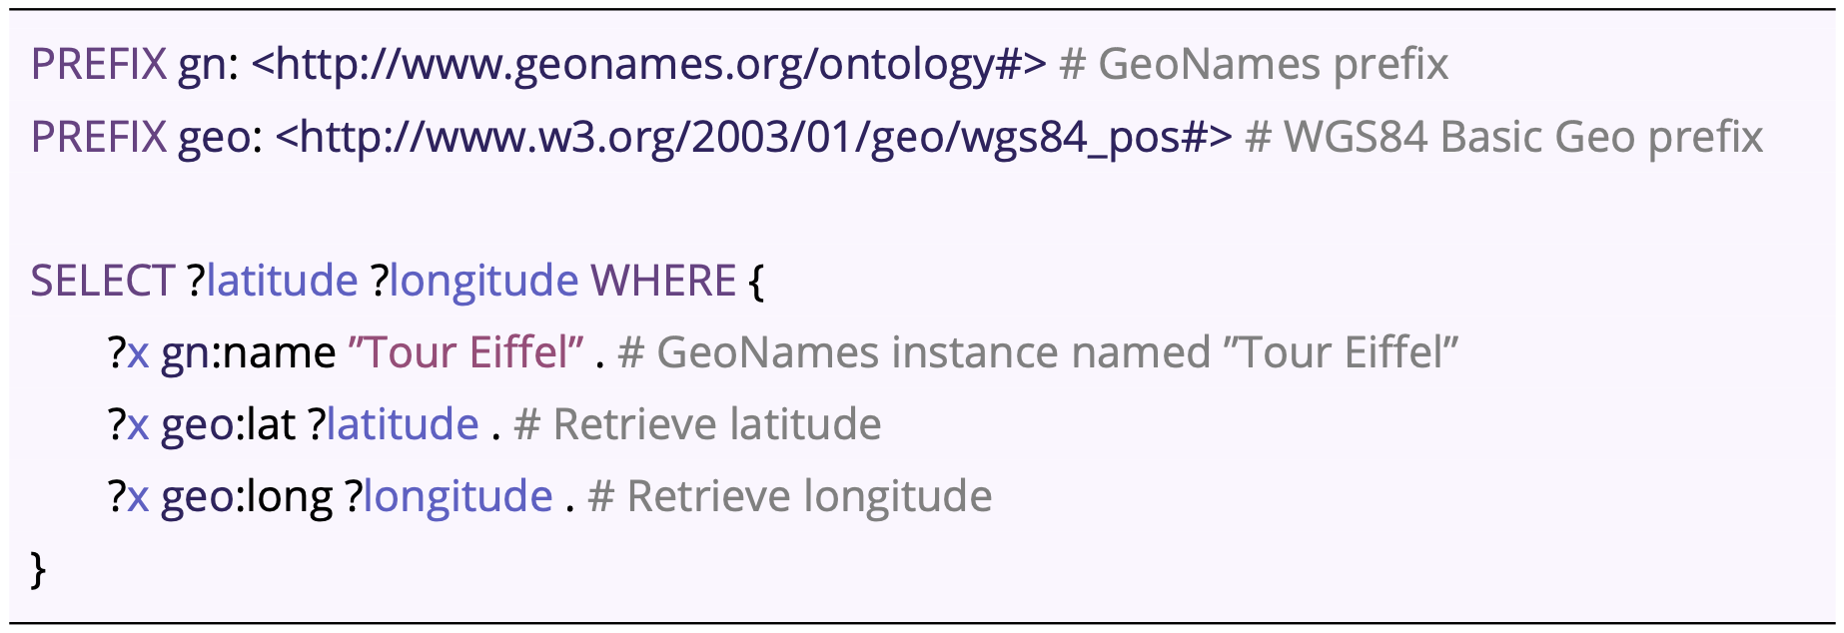
SPARQL

Slide 17
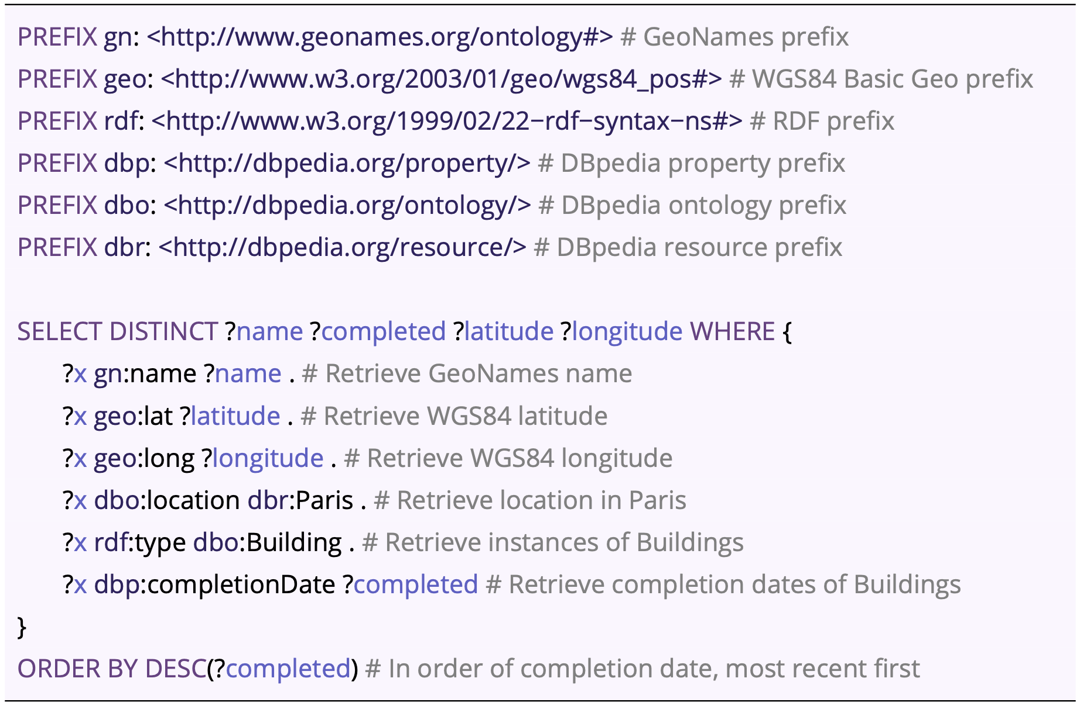
SPARQL

Slide 18
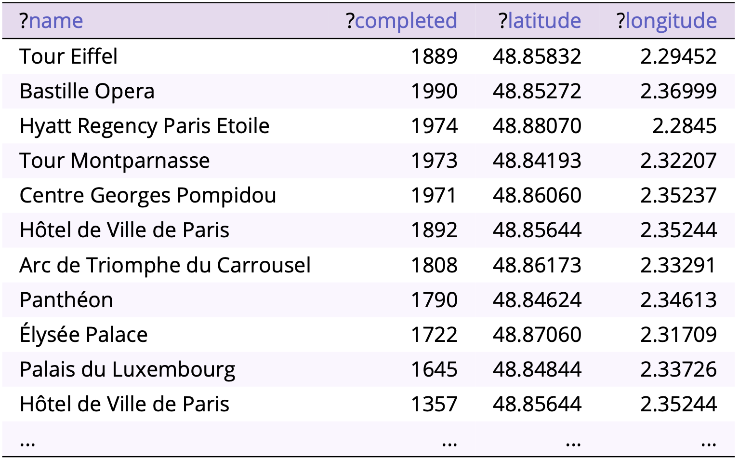
SPARQL

Slide 19
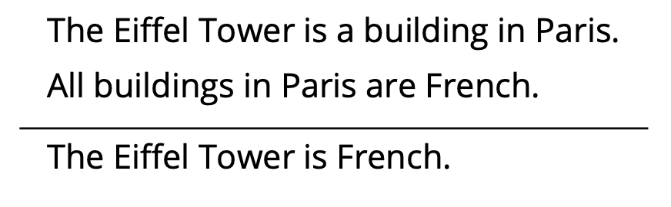
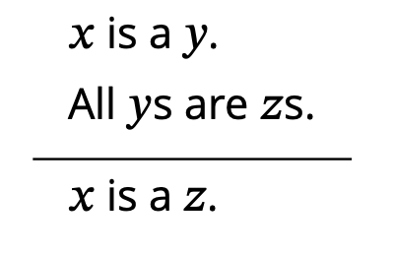
Reasoning with ontologies
Reasoning is woven in to Semantic Web technologies
The proposition “The Eiffel Tower is French” below the line (the conclusion) follows from the sentences above the line (the premises) by deduction
The process is quite general, and independent of the meanings of the individual terms
A collection of RDF triples forms a knowledge base
Deductive reasoning over the knowledge base can occur “on-the-fly” using SPARQL

Slide 20
Principles of ontology engineering
Congruity: Good ontologies reuse existing vocabularies and concepts, helping to link data together by building upon established terms, definitions, and concepts
Modularity: Good ontologies are modular in that they describe carefully scoped and bounded domains in a way that is accessible and understandable by others, not only by the individuals or expert communities who developed them
Consistency: Good ontologies are consistent, avoiding circularity in definition and internal contradictions, and helping users to classify instances unambiguously.
Clarity: Good ontologies avoid basic errors in definition, such as failing to distinguish between entities and identifiers; objects in the world versus the digital artifacts that refer to them; and things in the world versus our knowledge of those things
Openness: Good ontologies are open, describing the semantics of data in a way that promotes reasoning about linked data

Slide 21
Process of ontology engineering
Reuse: every ontology engineering project should begin by identifying the existing upper-level and domain ontologies relevant to the domain
Enumerate: enumerate the terms relevant to the domain, taking special care to be consistent in usage, for example, alert to synonyms and homonyms
Structure: structure the terms into a hierarchy, taking care to ensure each instance of a subclass A “is an” instance of superclass B
Relate: define the properties of each class and the relationships to literals and other classes
Iterate: iterate a process of revision and refinement, involving a diverse team of developers that includes subject matter experts, ontology engineers, and generalists
See: Noy & McGuinness (2001)

Slide 22
Section 9.2
Qualitative spatial reasoning

Slide 23
Qualitative versus quantitative
An approach is quantitative if it is based on analysis of numerical (interval or ratio) data
An approach is qualitative if it is based on analysis of classifications and ordering (nominal and ordinal data)
Qualitative representation and reasoning with spatial and temporal data is important because:
Qualitative properties are simple, usually involving small, discrete representations that are inherently tolerant to imprecise human knowledge
Qualitative properties supervene on quantitative properties, in the sense that qualities can always be derived from quantities
The boundaries between qualities usually correspond to salient discontinuities for humans
Qualitative spatiotemporal reasoning (QSR) is an area of study within KR² that has developed a variety of logical systems for representing and reasoning about qualitative spatial and temporal objects and relations

Slide 24
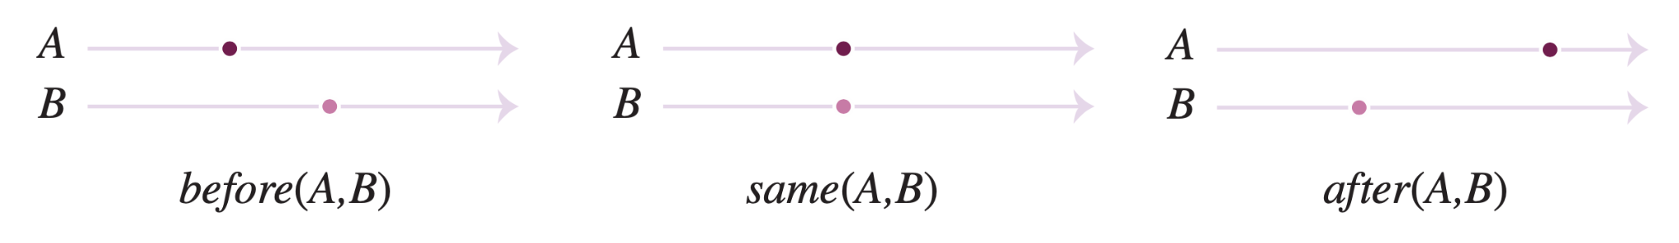
Point algebra: representation
The point algebra describes three qualitative relations between two points in time
The different relations are chosen so as to be jointly exhaustive pairwise disjoint (JEPD): one and only one of these relations will necessarily hold between any two points in time
See: Vilain & Kautz (1986)

Slide 25
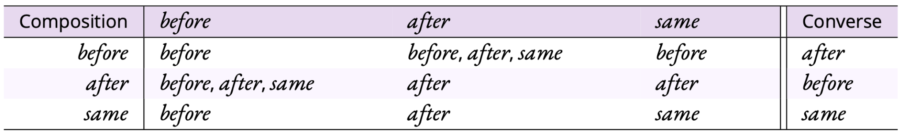
Point algebra: reasoning
Converse operation, e.g., before(A, B) implies after(B, A)
General form: R(X, Y) implies R(Y, X)
Composition operation, e.g., before(A, B) and before(B, C) implies before(A, C)
General form: R(X, Y) and R(Y, Z) implies R(X, Z)

Slide 26
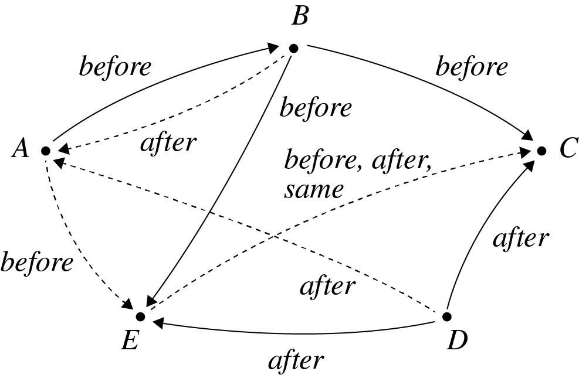
Constraint network

Slide 27
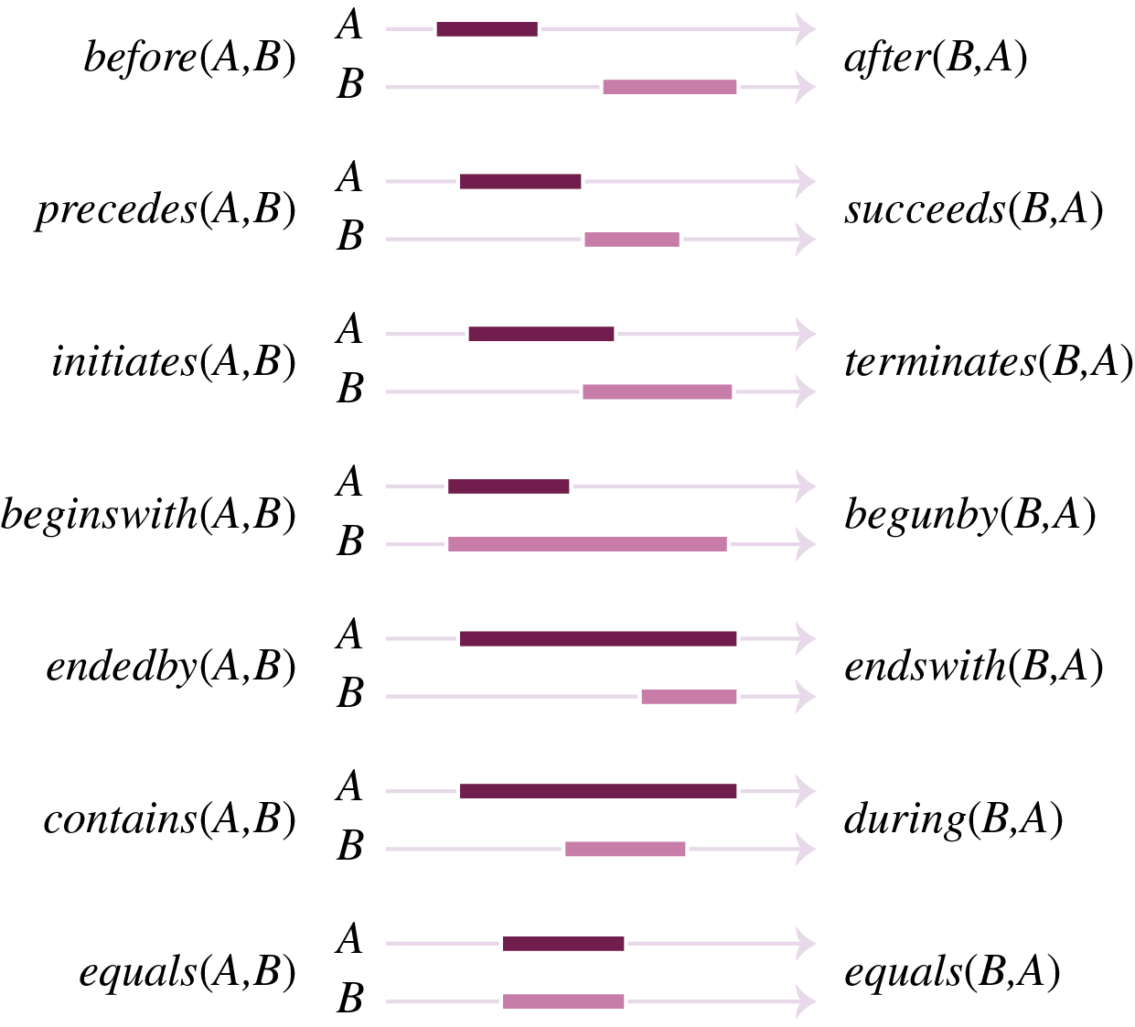
Interval algebra: representation

Slide 28
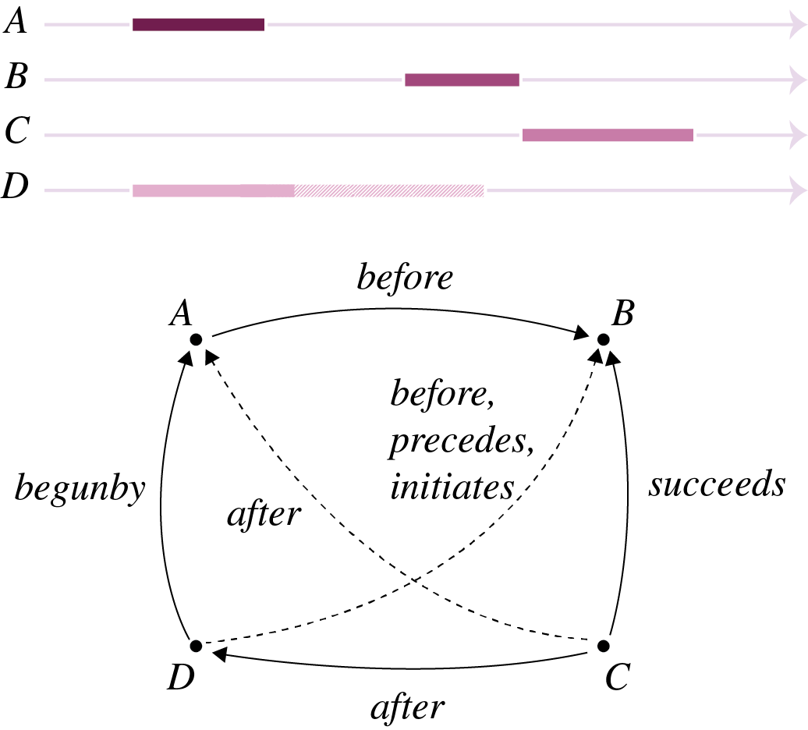
Interval algebra: reasoning

Slide 29
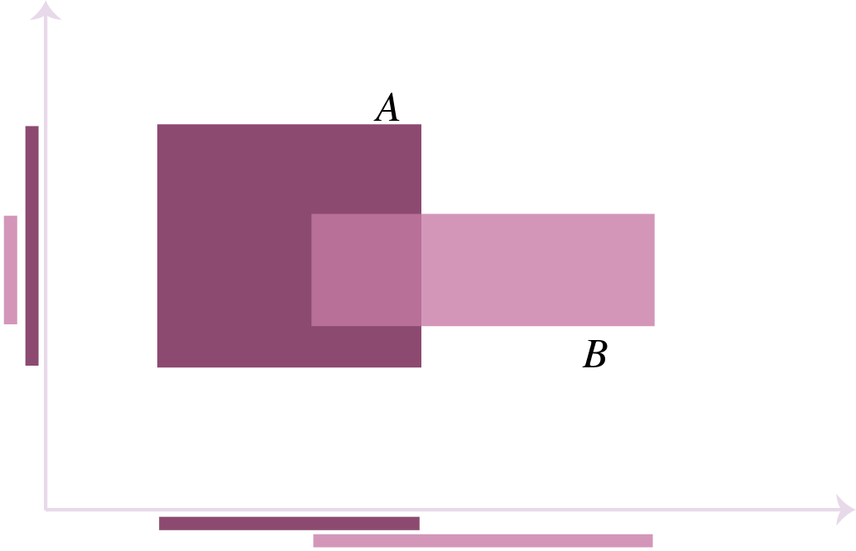
Rectangle algebra

Slide 30
Region connection calculus (RCC)
RCC is founded on Clarke’s calculus of individuals
We write C(X, Y) as shorthand for “region X is connected to region Y”
The connection relation is reflexive and symmetric, satisfying the following axioms:
For each region $X$, $C(X, X)$
For each pair of regions X, Y, if C(X, Y) then C(Y, X)

Slide 31
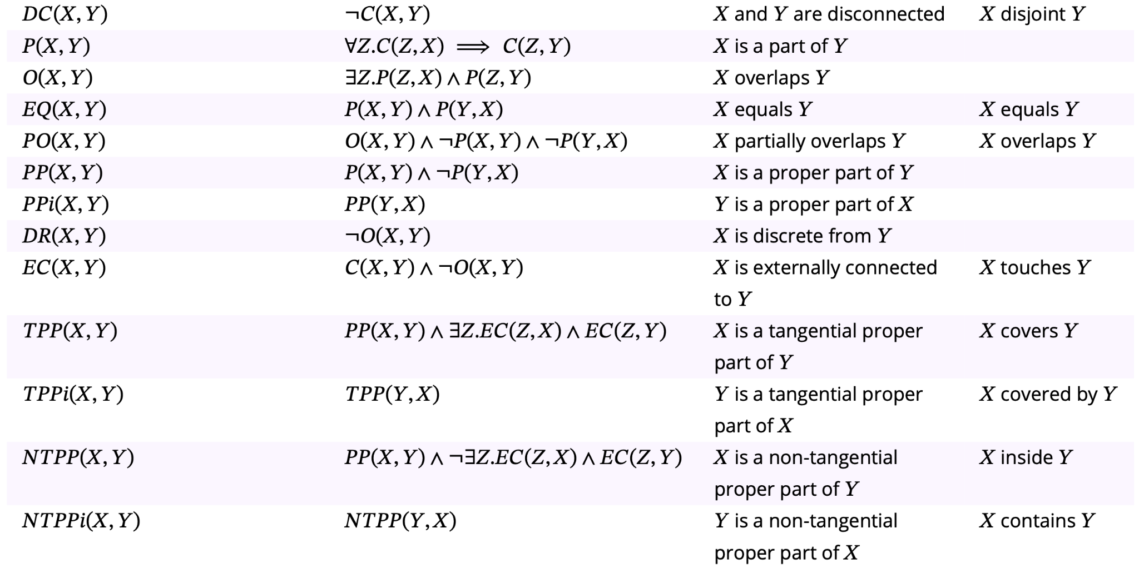
Region connection calculus (RCC)
Relation Definition Description 4IM relation

Slide 32
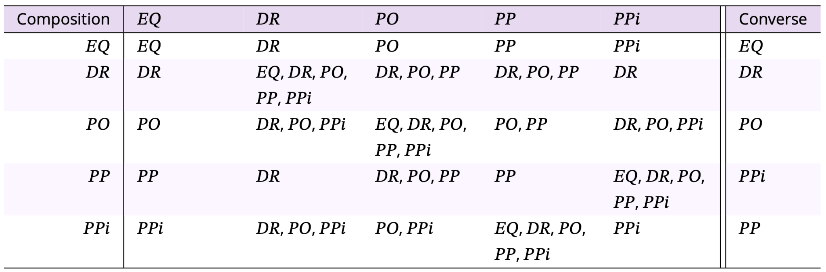
RCC 5: Reasoning

Slide 33
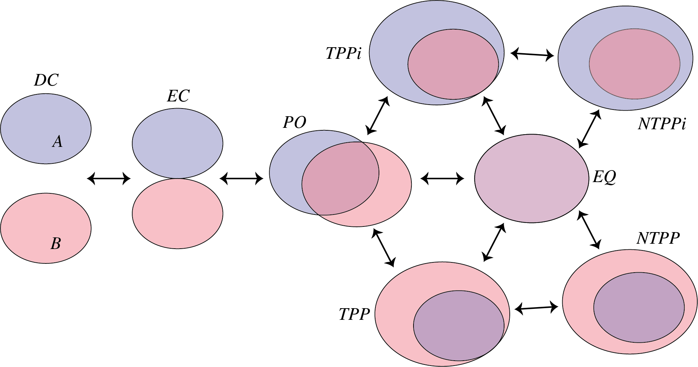
RCC 8: Conceptual neighborhood

Slide 34
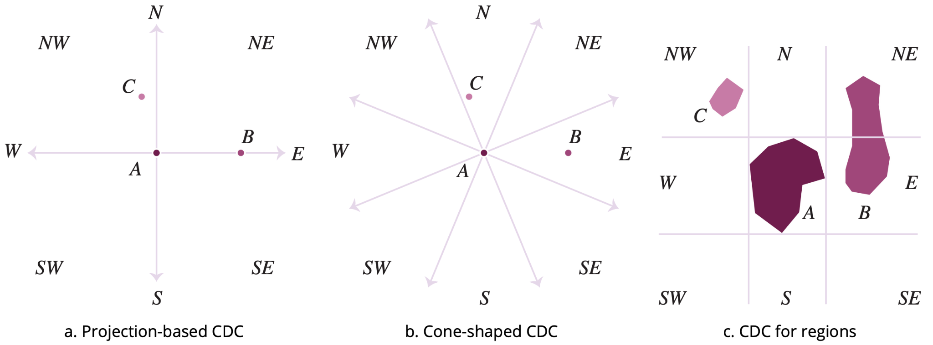
Cardinal directions: representation

Slide 35
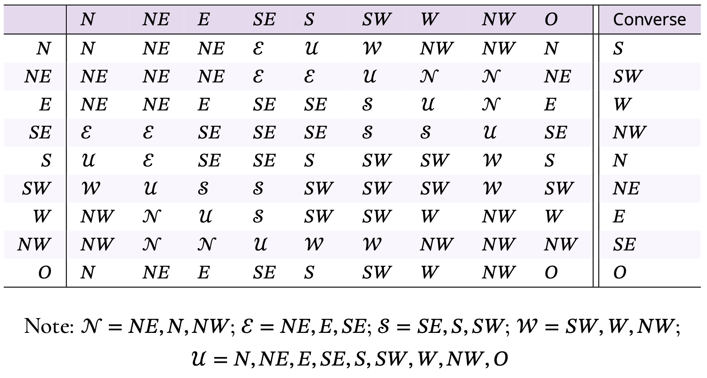
Projection-based CDC: reasoning

Slide 36
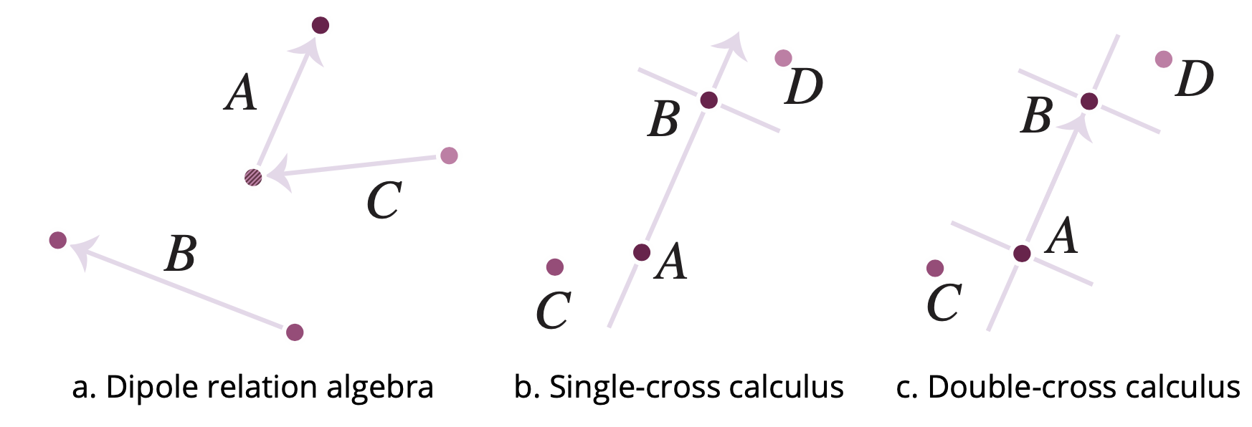
Egocentic directions: representation

Slide 37
Section 9.3
Machine learning

Slide 38
Machine learning tasks
The wide range of problems that machine learning can help solve can be categorized into three main tasks:
Clustering is the task of learning “natural” groupings from within data called clusters, such that the similarity of data items within each cluster is greater than the similarity of items between clusters
Classification is the task of learning to predict qualitative class labels that can be associated with input data
Regression is the task of learning to predict quantitative values associated with input data

Slide 39
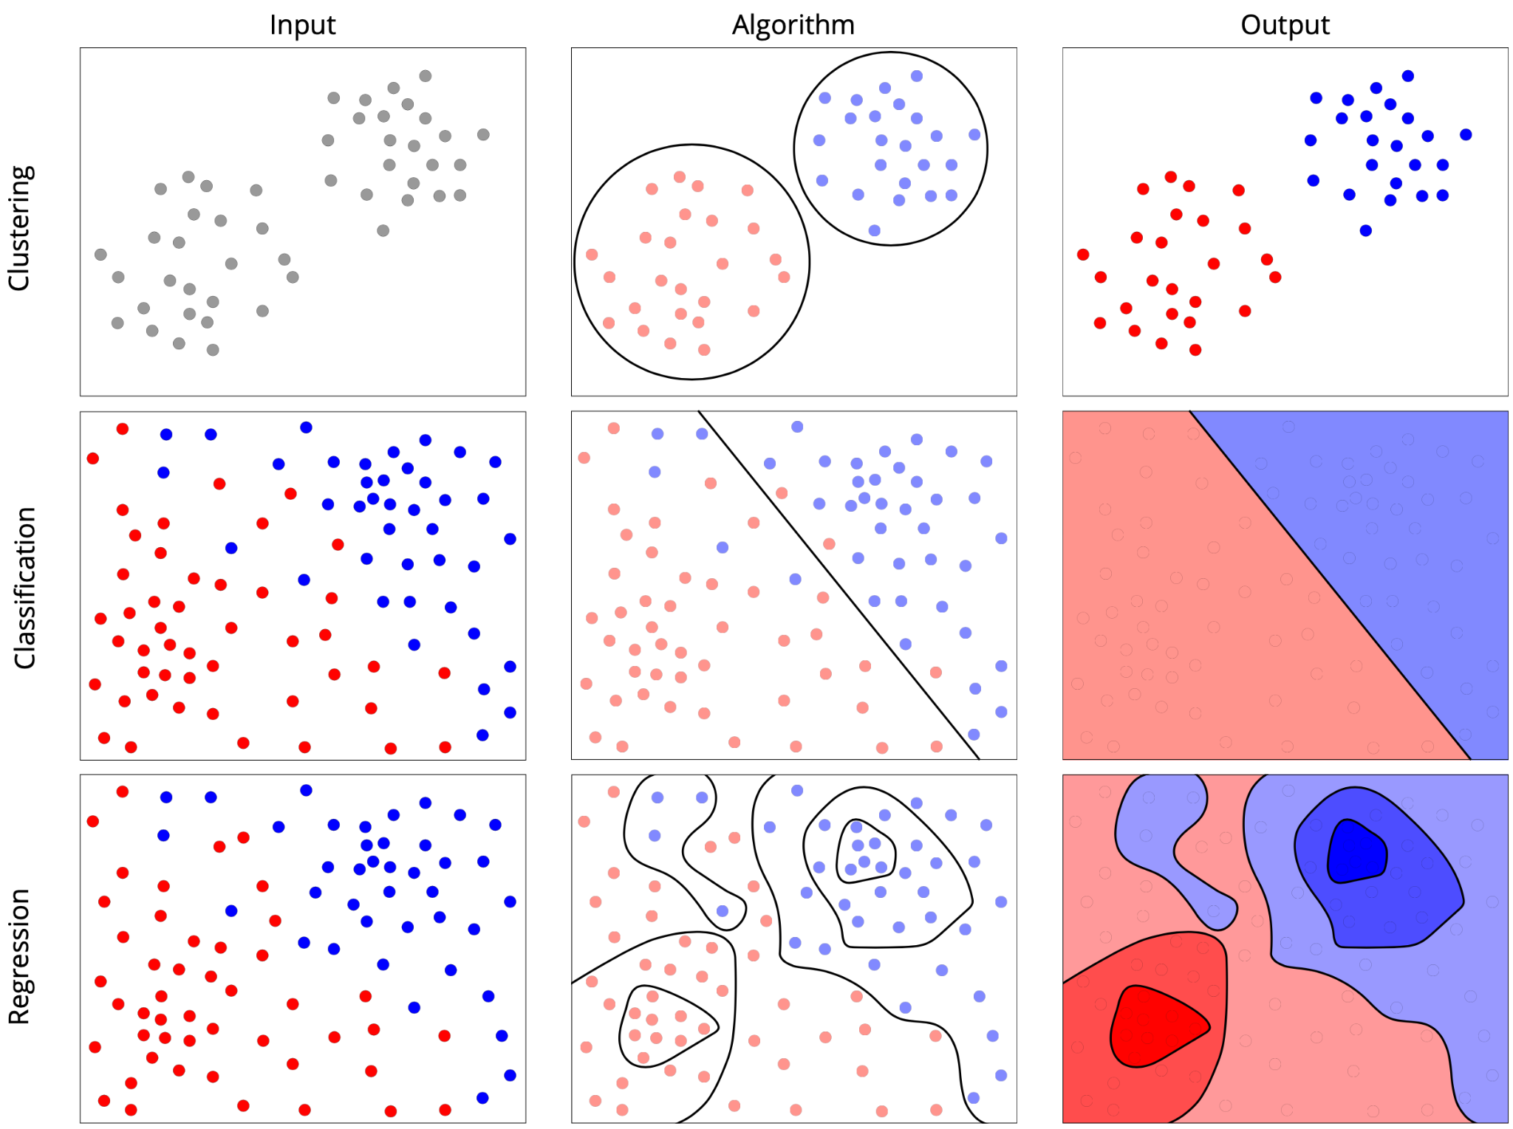
Machine learning tasks

Slide 40
Machine learning workflow
The machine learning workflow can be summarized into four basic steps:
Preparation: raw data needs processing, restructuring, and data cleaning transforming the source data into a clean and compatible format and structure, termed data wrangling
Training: training involves conditioning an ML model to the data provided
training data sets often need to be manually labeled by a human, termed supervised learning
some ML techniques are conditioned directly on data without the need for any labels, termed unsupervised learning
Evaluation: explores how well the training process has performed, in two components:
validation occurs while the model is being trained on a reserved portion of the data called the validation data set
testing occurs after the model has been built on another reserved portion of the data, called the test data set
Output: a successful machine learning workflow will construct a trained and evaluated model able to solve one of the three problem types: clustering, classification, and regression

Slide 41
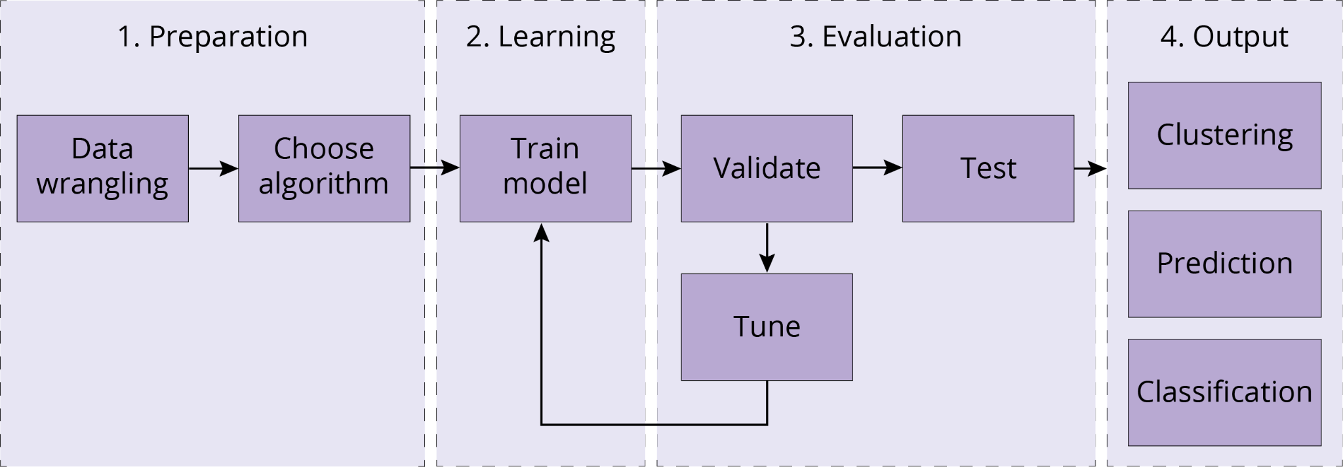
Machine learning workflow

Slide 42
Evaluation and overfitting
Statistical measures of spread such as standard deviation, mean square error (MSE), and R² help to evaluate the quality of learning with quantitative data
Metrics based on errors of commission (items placed in a class X that should not have been) and errors of omission (items not placed in a class X that should have been) support evaluation with quantitative data
A confusion matrix cross tabulates errors of omission and errors of commission
Overall classification accuracy can be captured as the number of correct classifications as a proportion of the total number of classified data items
For individual categories, three further metrics are widely used:
True positive rate (TPR), also called sensitivity or recall, measures the data correctly classified as a proportion of all the data classified
Positive predictive value (PPV), also called precision, is a measure of the data correctly classified as a proportion of the data that should have been so classified
F1 score is a mean of TPR and PPV
Overfitting is the common error in machine learning where the model corresponds too closely to the input data set, at the expense of learning something generalizable about the data

Slide 43
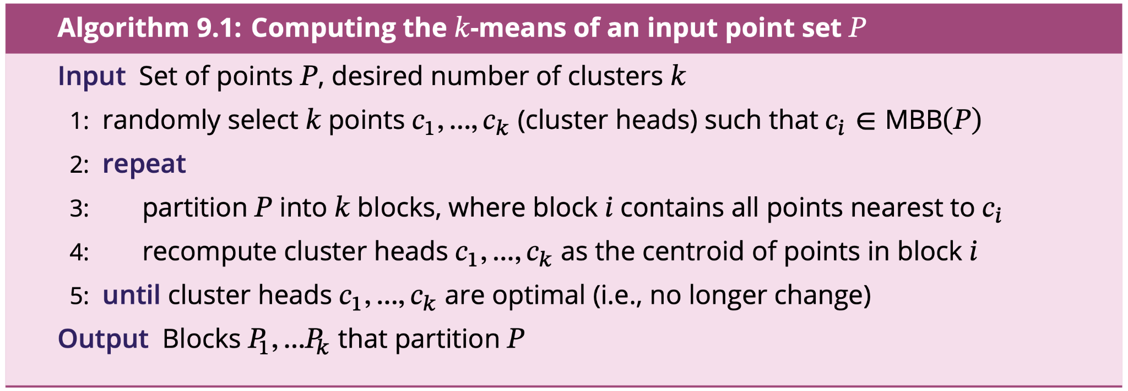
Clustering: k-means
k-means clustering partitions an input data set into k clusters such that the arithmetic mean (centroid) of each cluster is closer to every data point in the cluster than to any data point in another cluster

Slide 44
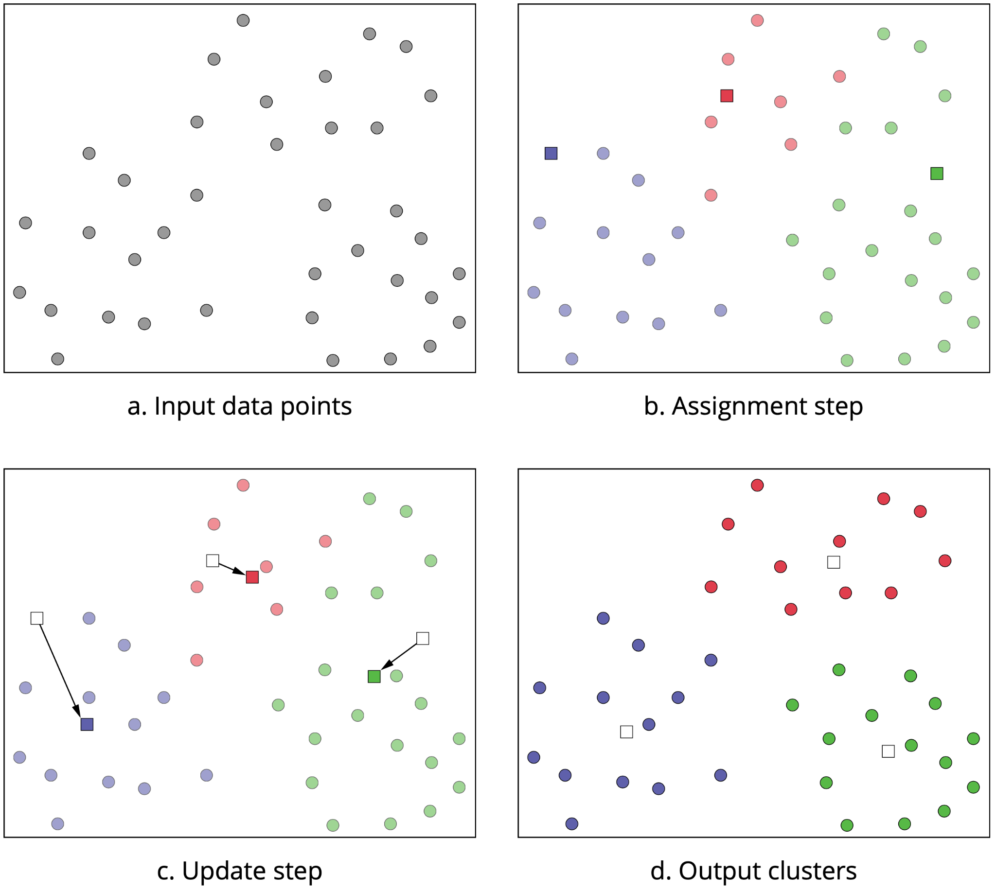
Clustering: k-means

Slide 45
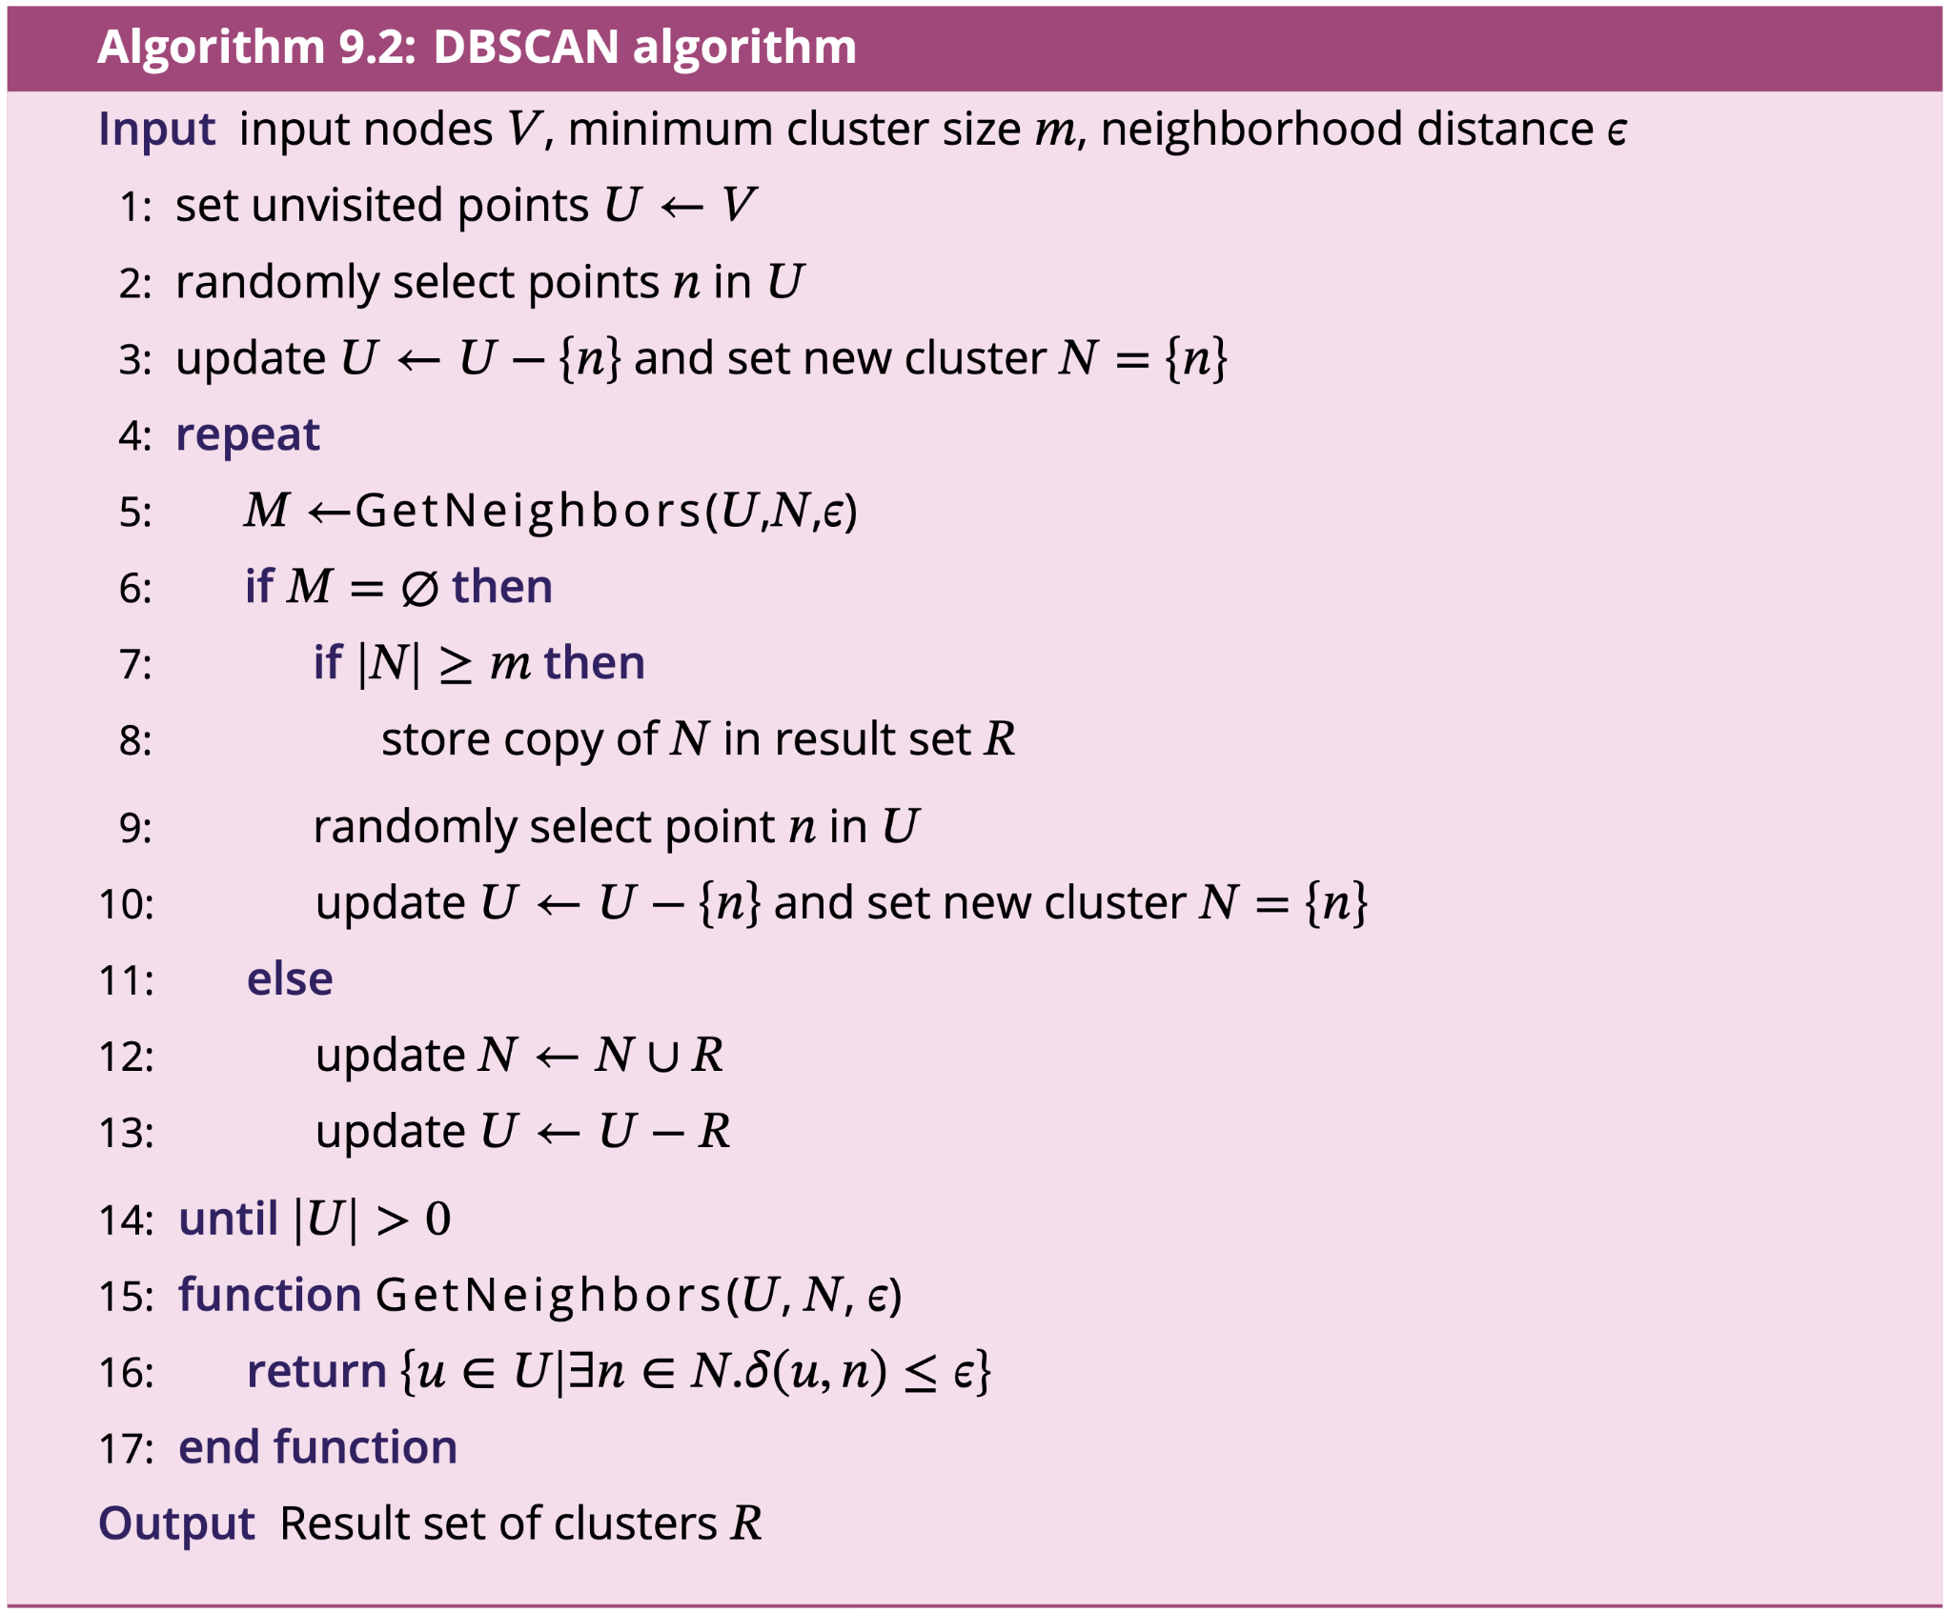
Clustering: DBSCAN
DBSCAN (density-based spatial clustering of applications with noise) identifies groups of more densely packed points, and is able to exclude outlier points that do not fit well in any cluster

Slide 46
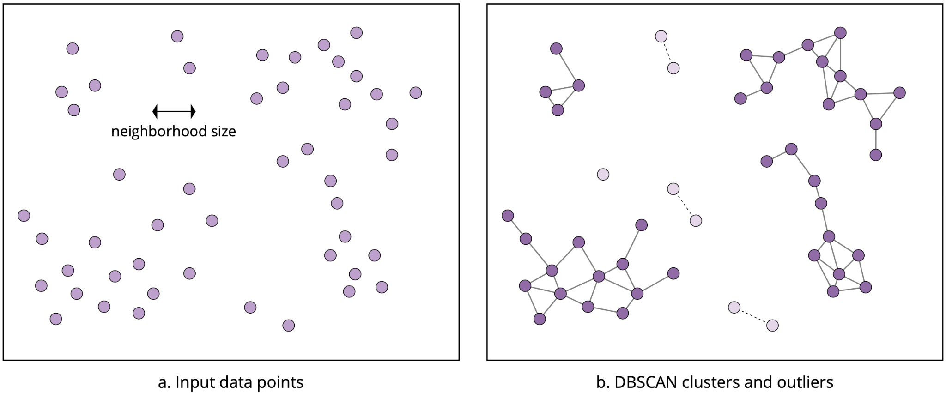
Clustering: DBSCAN

Slide 47
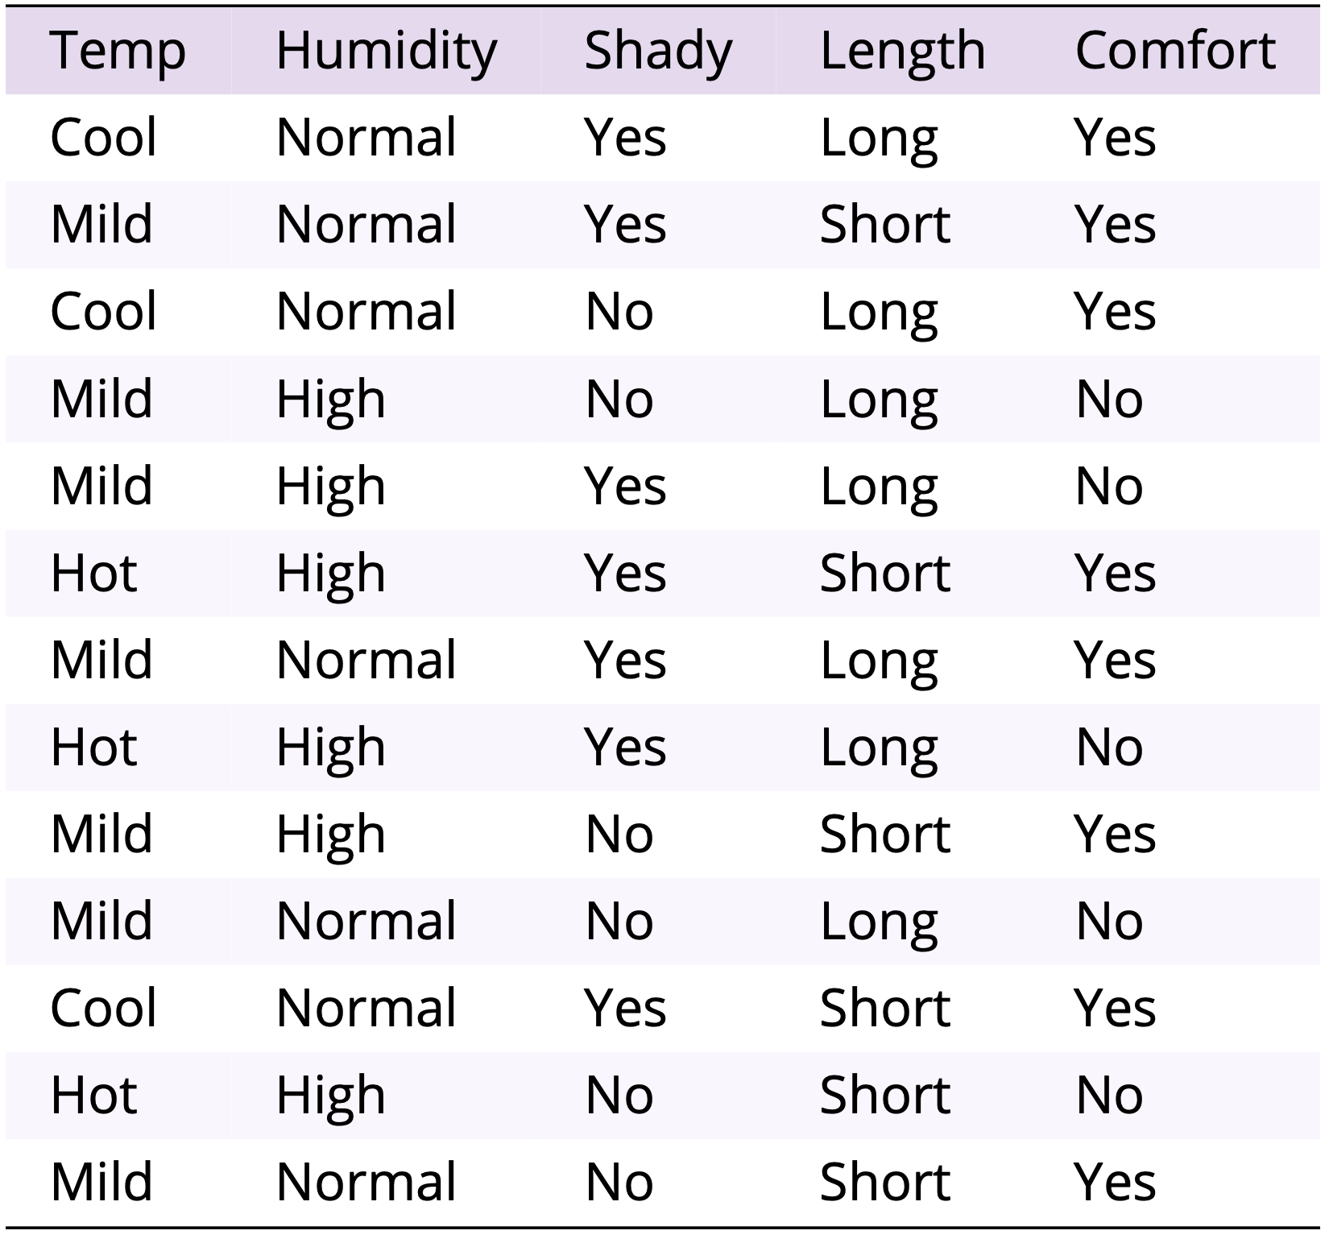
Classification: Decision tree
Decision tree learning involves the construction of a decision tree that models the key decisions behind the classification process
A decision tree is a directed acyclic graph where:
each non-leaf node in the decision tree represents a logical test that can be performed on the data;
a directed edge represents one potential outcome of the test indicated by the source node of that edge; and
each leaf node represents an outcome of the classification process.

Slide 48
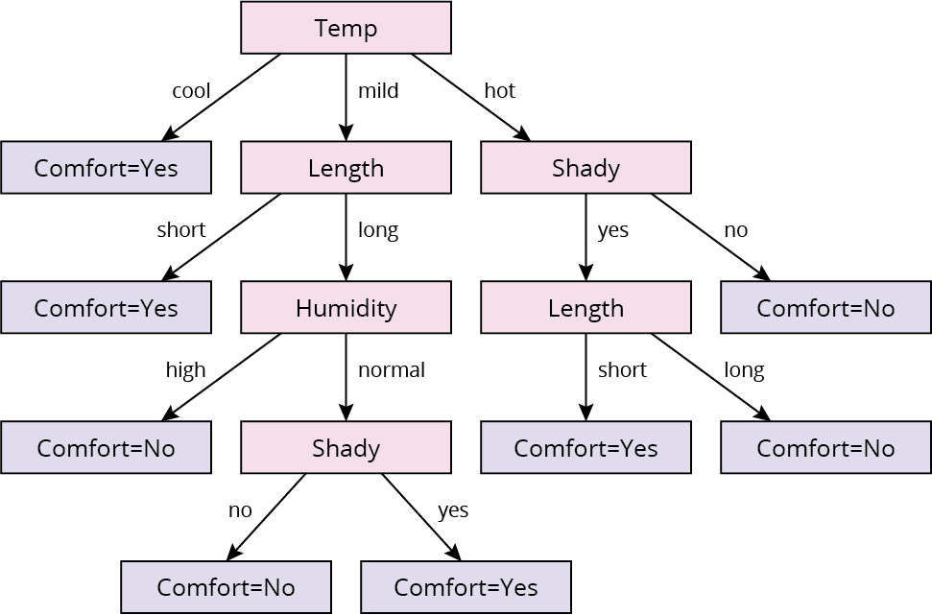
Classification: Decision tree

Slide 49
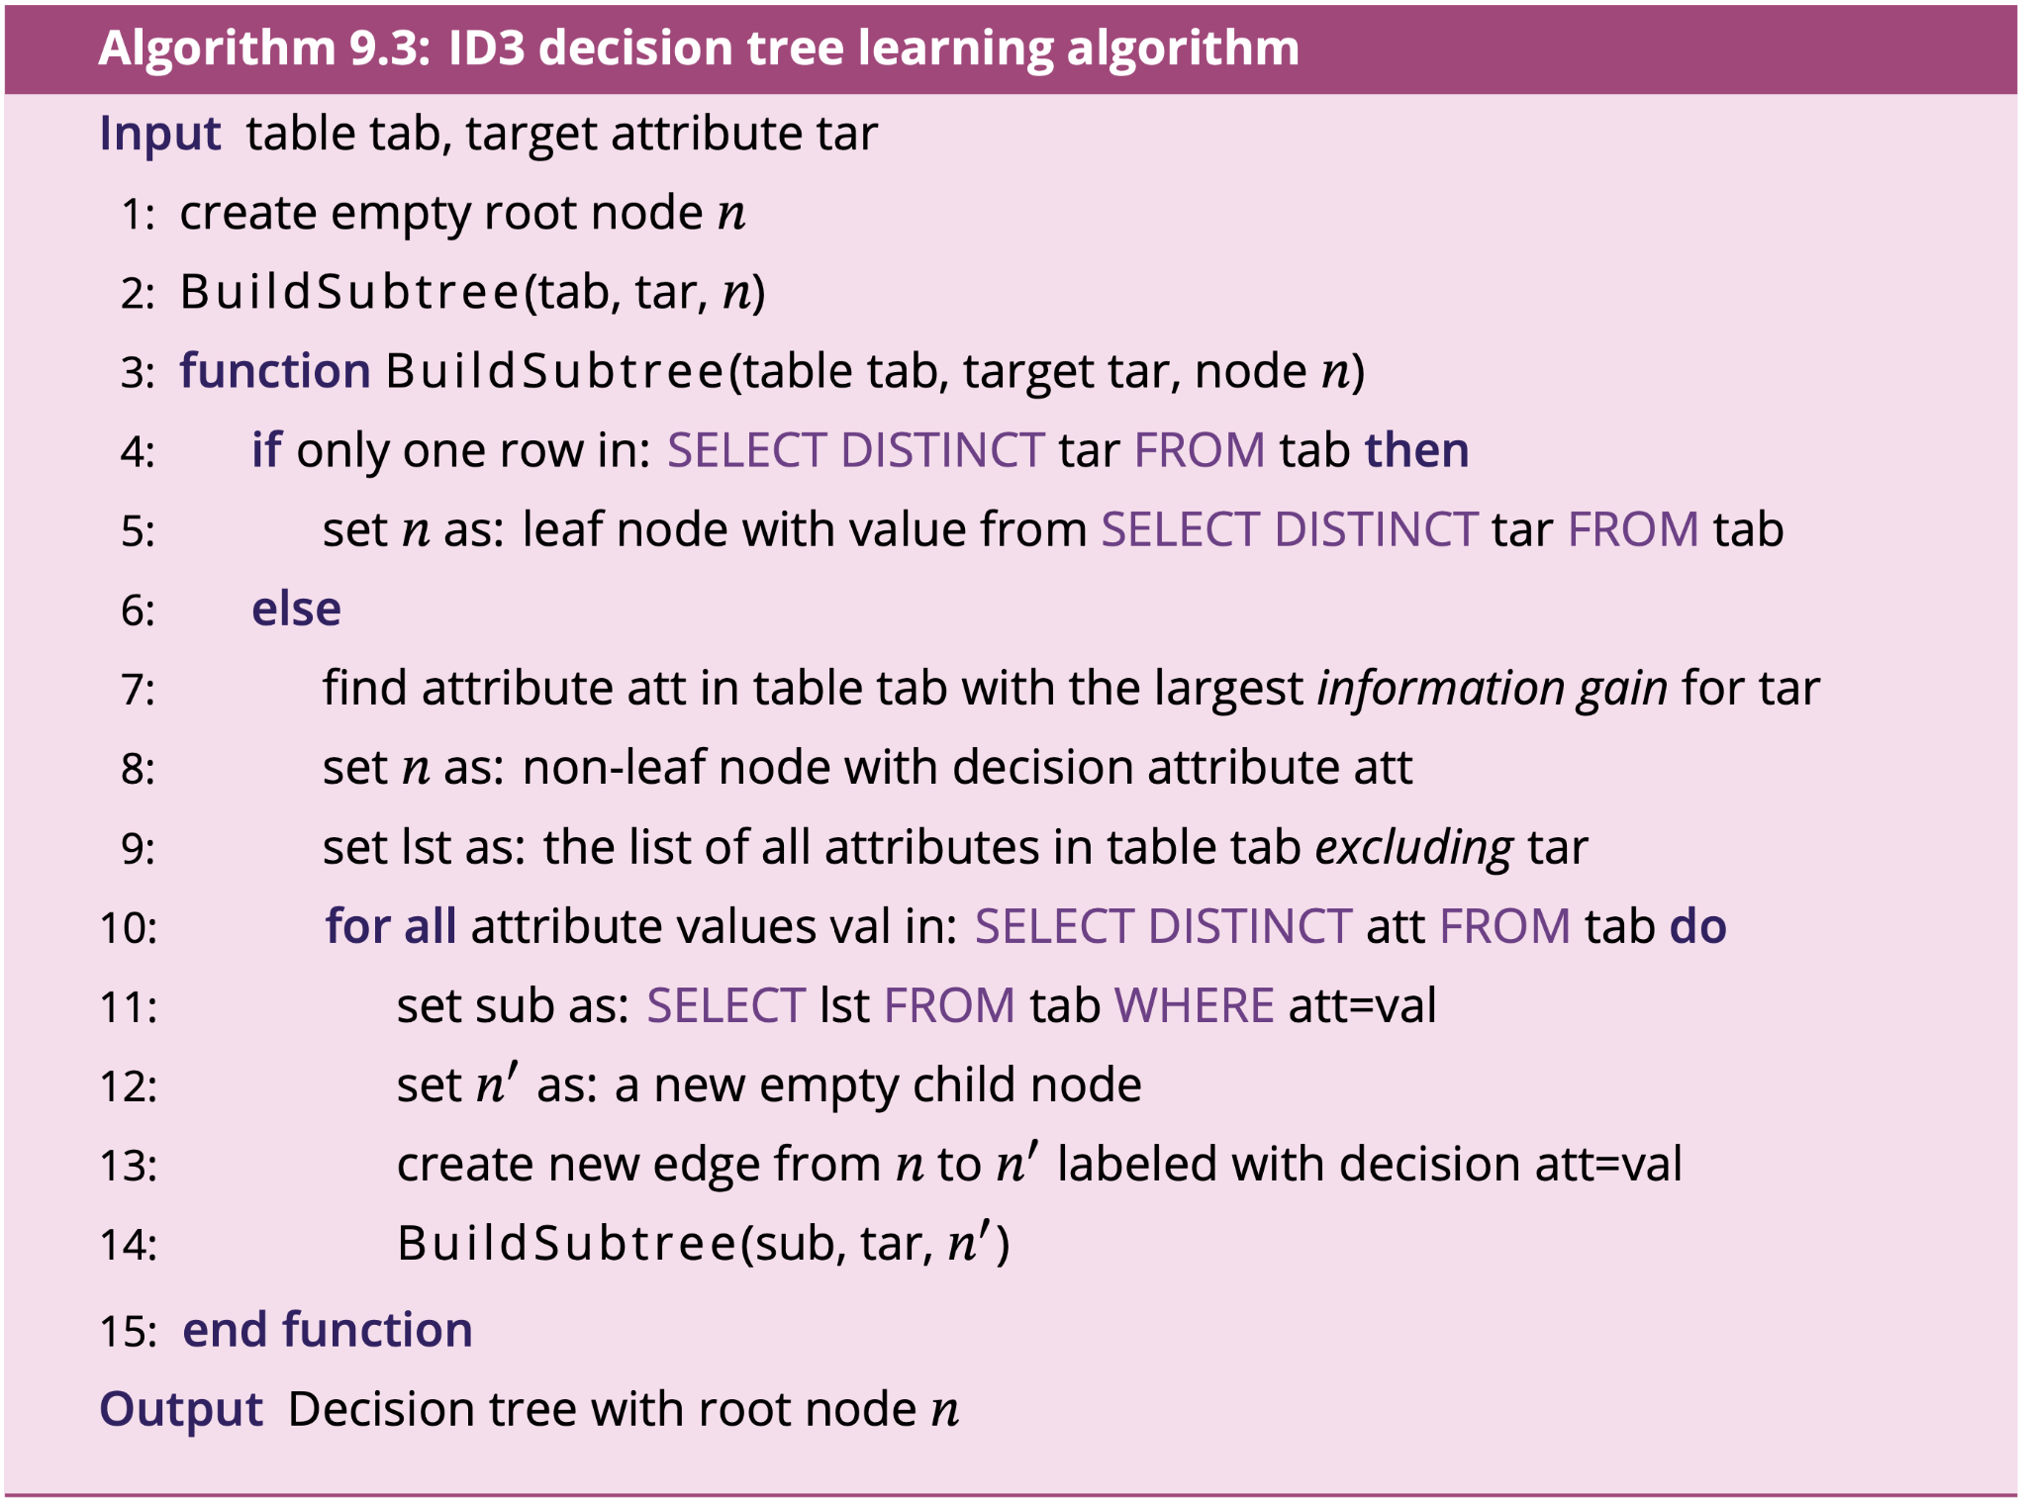
Classification: Decision tree

Slide 50
Classification: Random forests
A random forest is a collection of decision trees grown from randomized samples of the input data
A random forest may take many hundred such random samples in order to grow hundreds of trees
Classification then uses majority voting from across all the trees in the forest
The approach of learning multiple models from data and then recombining the set of model outputs into a final output is a common technique in machine learning, termed ensemble learning
Ensemble learning tends to increase overall stability and accuracy of learning outputs, reducing the tendency to overfitting

Slide 51
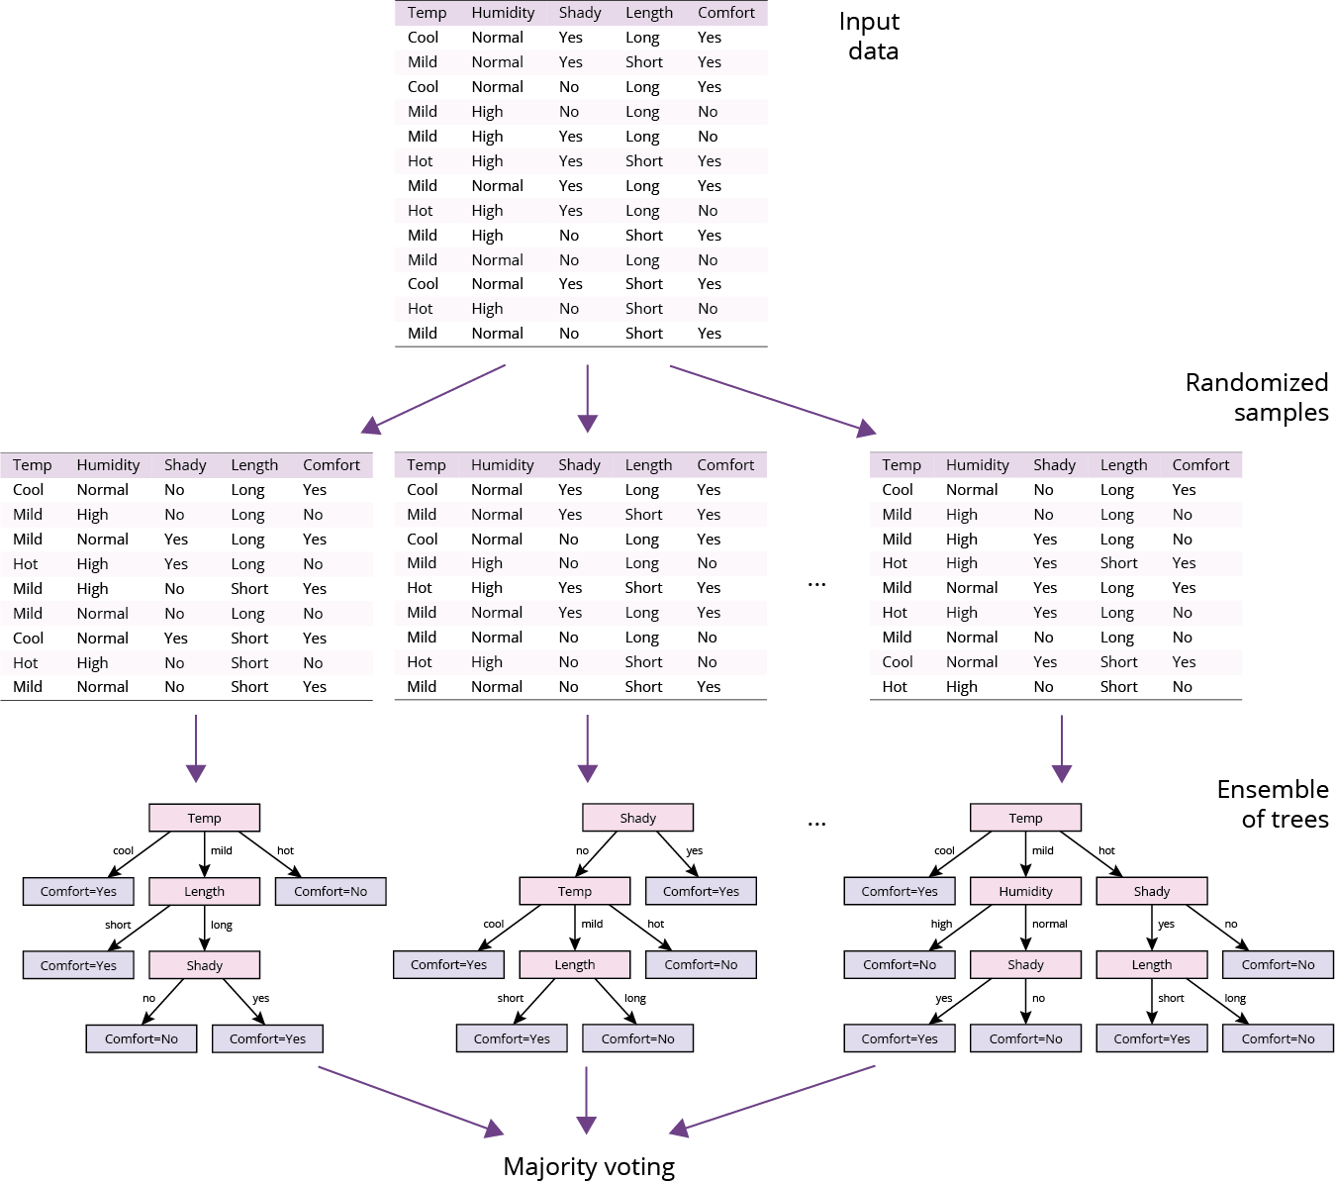
Classification: Random forests

Slide 52
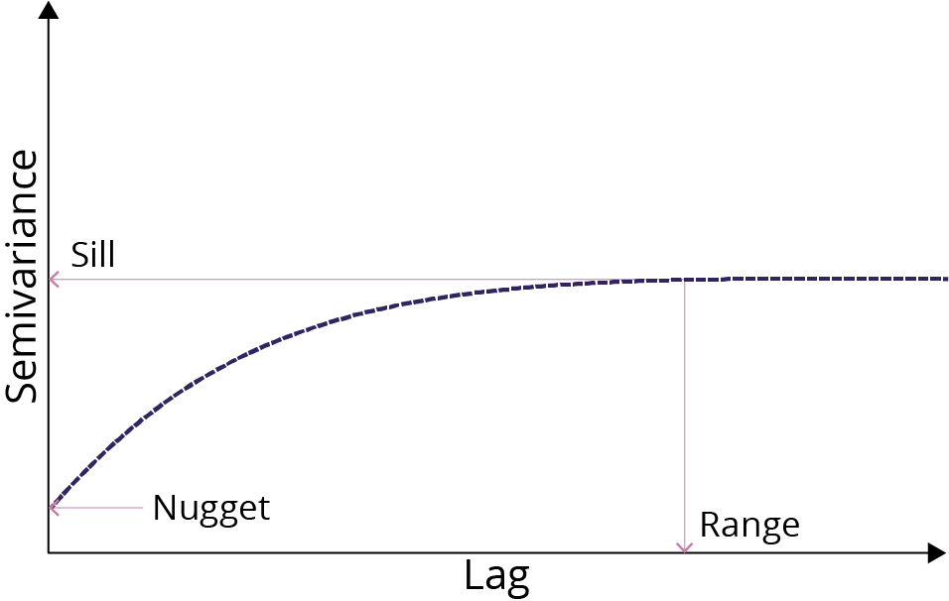
Regression: Semivariogram
The x-axis measures the distance between pairs of points in spatial data, termed lag
The y-axis measures the average of variation between points at that lag, semivariance
The intercept of the curve with the y-axis is termed the nugget
Semivariance increases with increasing lag (because near things are more related), but only up to a certain level, termed the sill
The lag beyond which semivariance no longer appreciably increases is called the range

Slide 53
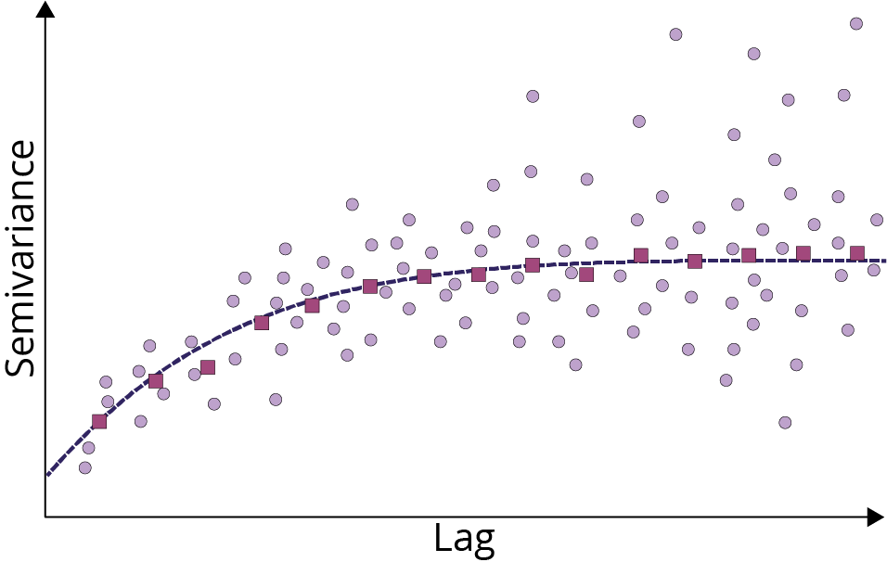
Regression: Kriging
The semivariogram is at the root of the ML regression technique of Kriging
Kriging involves fitting (i.e., training) a semivariogram to a data set N of points by computing the semivariance between the sets of points at different lag distances
The output of this training process is a model of the autocorrelation in the data, based on the structure of the semivariogram

Slide 54
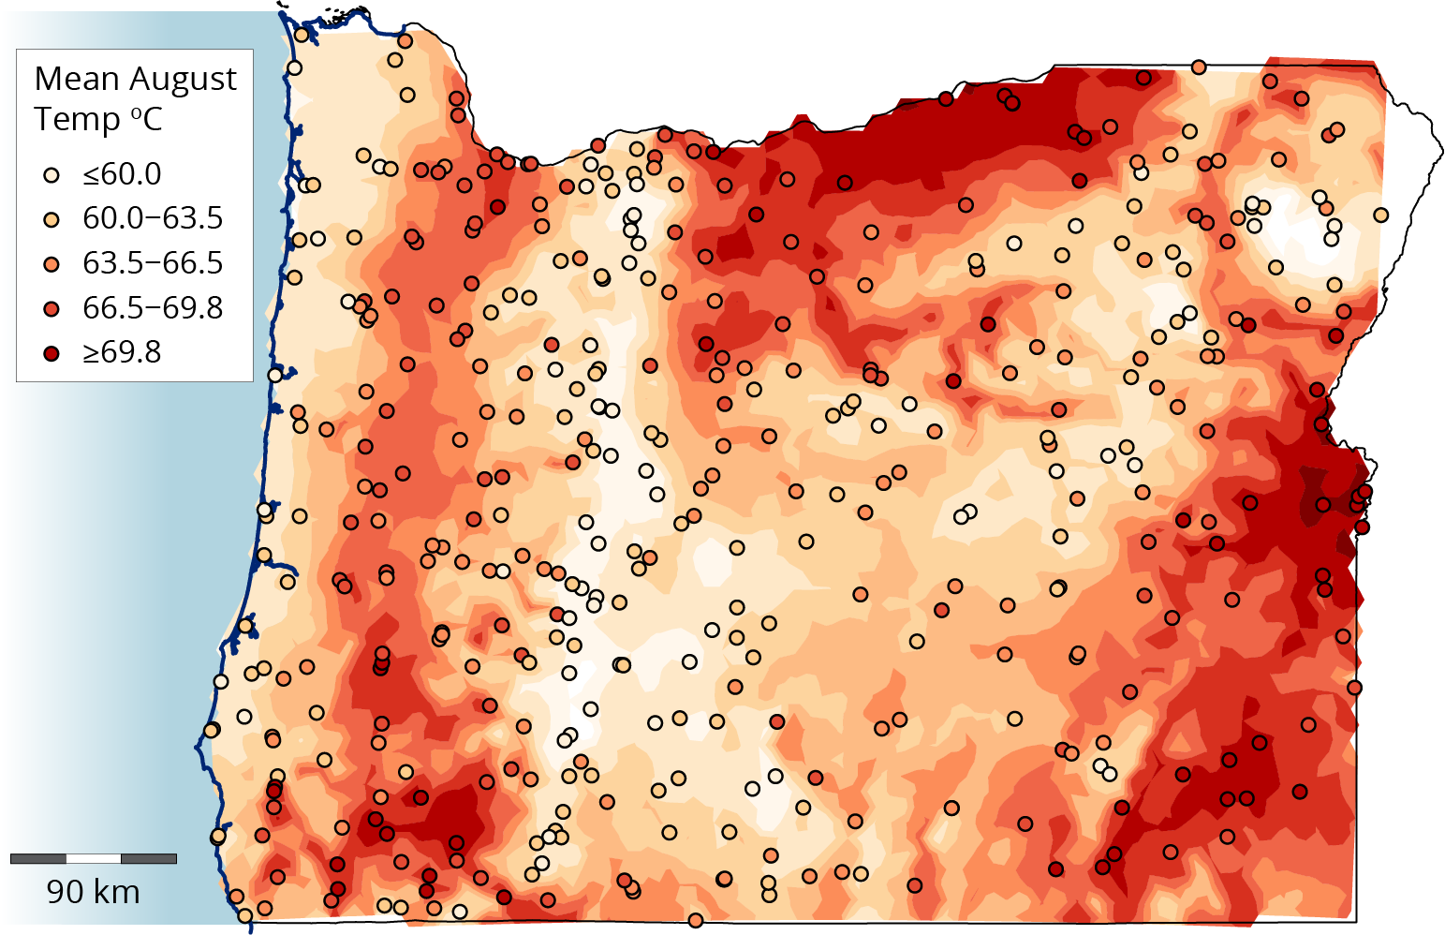
Regression: Empirical Bayesian Kriging

Slide 55
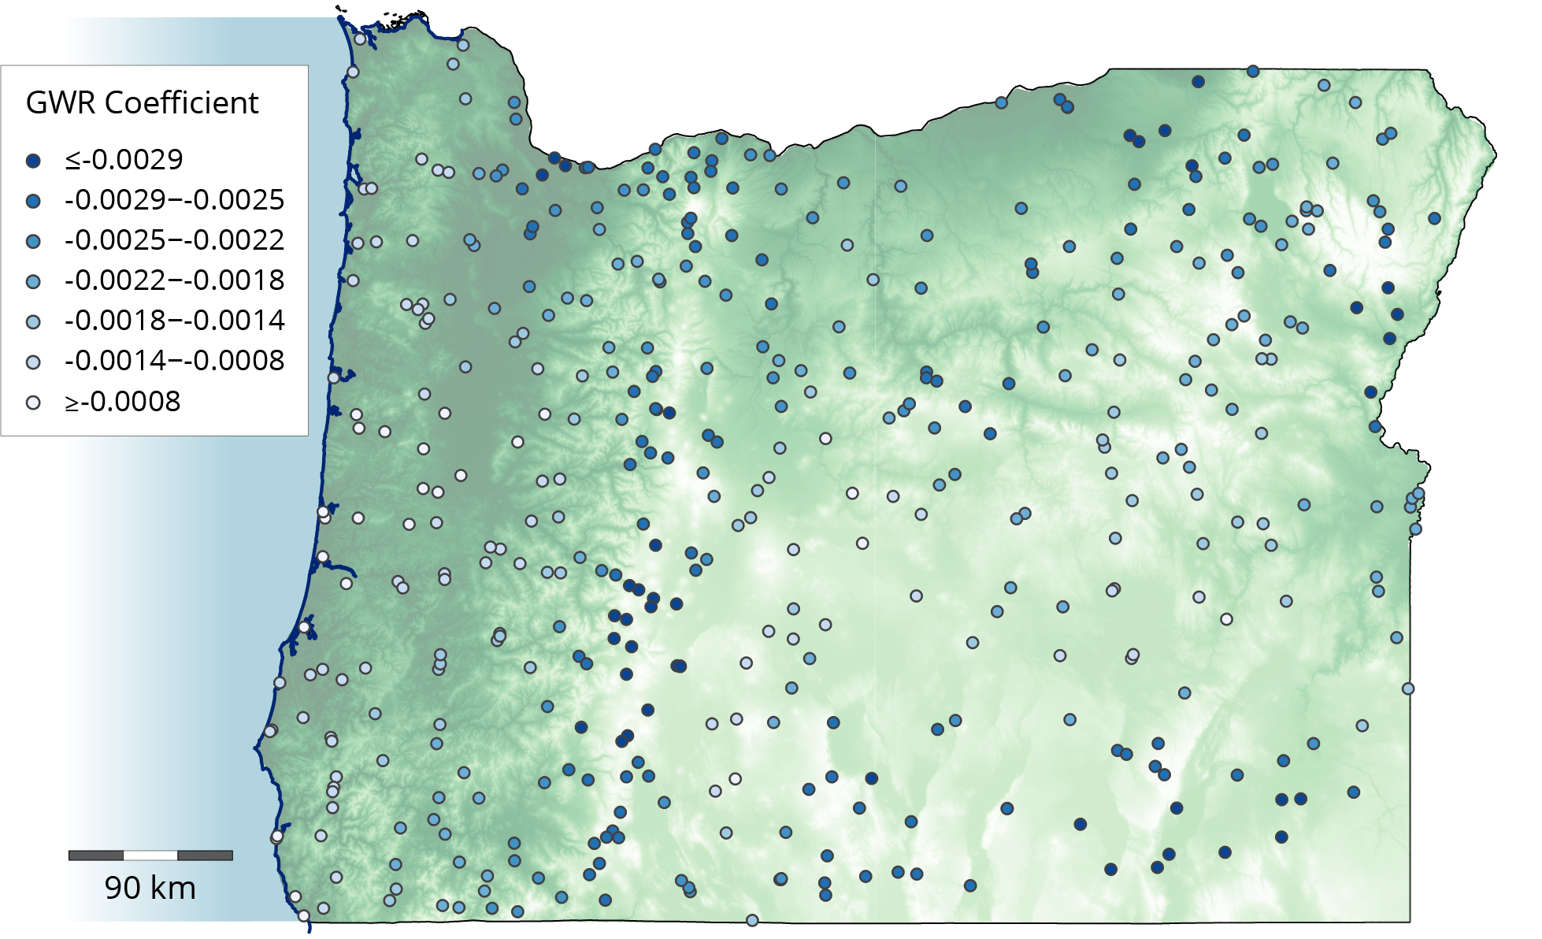
Regression: GWR
Whereas Kriging trains a model to estimate a variable at unknown locations, geographically weighted regression (GWR) trains a model to estimate the spatially varying and unknown relationship between different variables
GWR is a spatial extension of multiple linear regression, where training data is used to construct the relationship between a dependent variable and one or more independent variables

Slide 56
Section 9.4
Deep learning

Slide 57
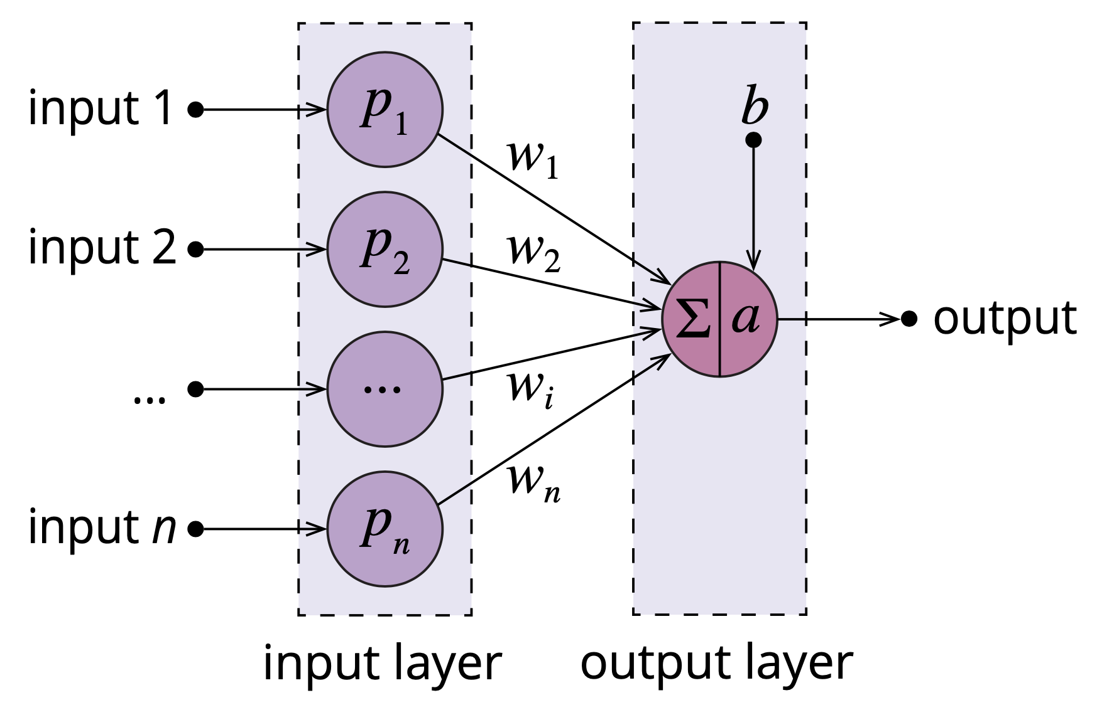
Artificial neural network: Perceptron
An artificial neural network (ANN) is a machine learning classification or regression algorithm
The simplest possible ANN, termed a perceptron, has multiple input nodes connected to a single output node by weighted directed edges
The output node computes the weighted sum of inputs, and it then applies an activation function to determine what output is generated
A feed-forward network only ever feeds data forward from inputs towards outputs

Slide 58
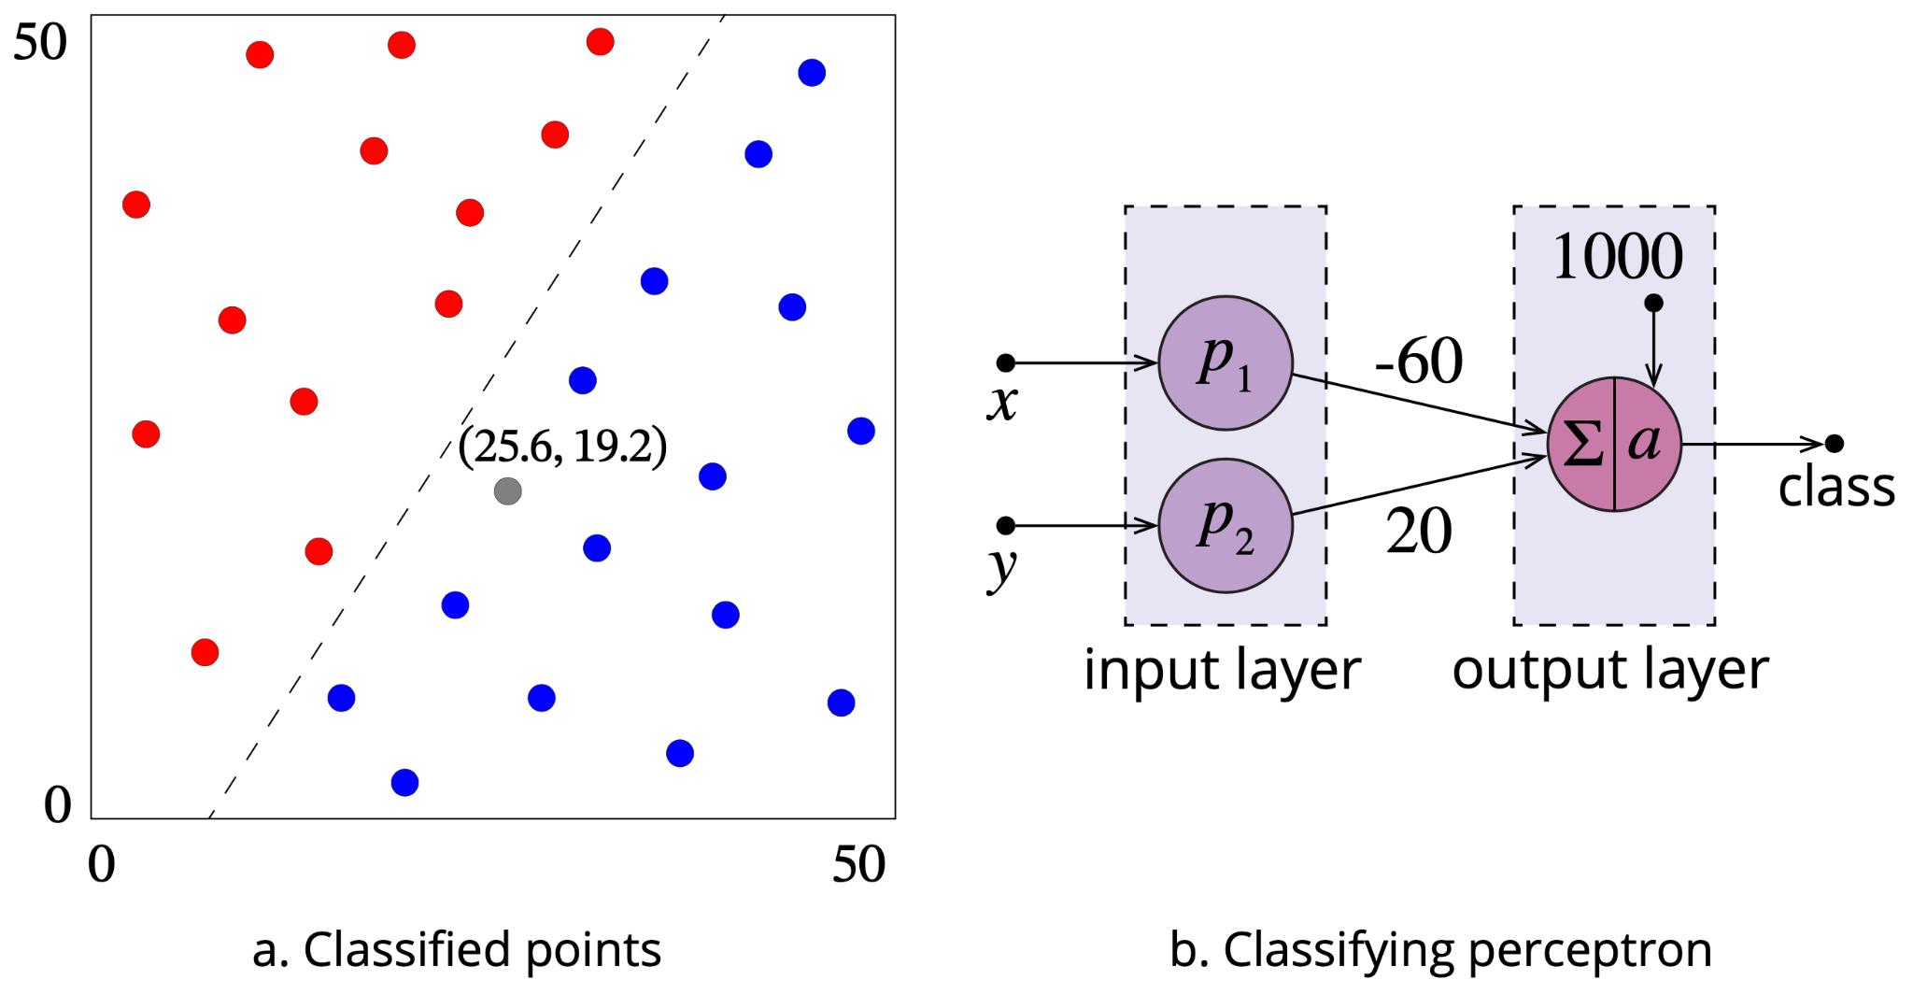
Artificial neural network: Perceptron

Slide 59
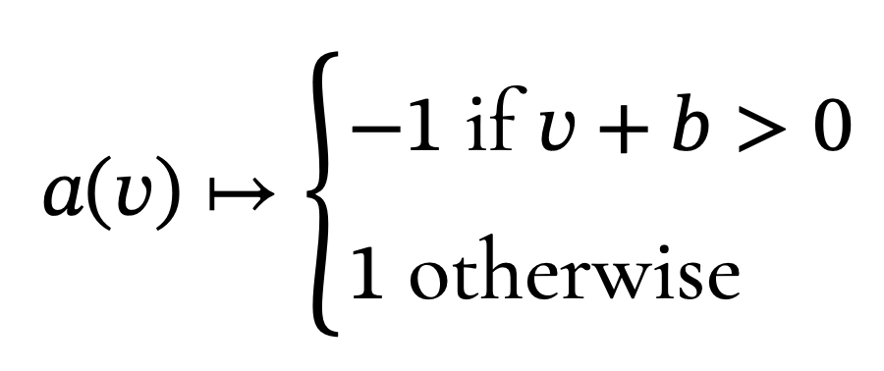
Artificial neural network: Perceptron
For example, the perceptron can correctly classify a new point with coordinate (25.6, 19.2) as a(-1152) = 1 (blue) since:
-60 x 25.6 + 20 x 19.2 + 1000 < 0

Slide 60
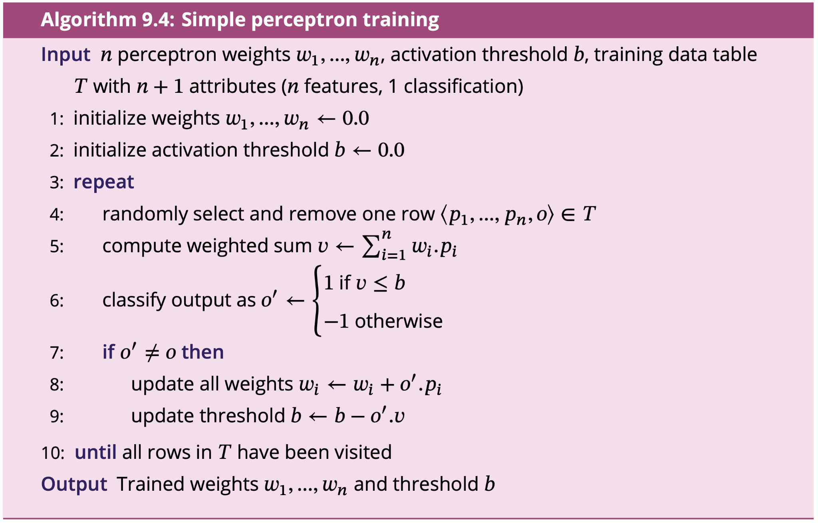
Artificial neural network: Perceptron

Slide 61
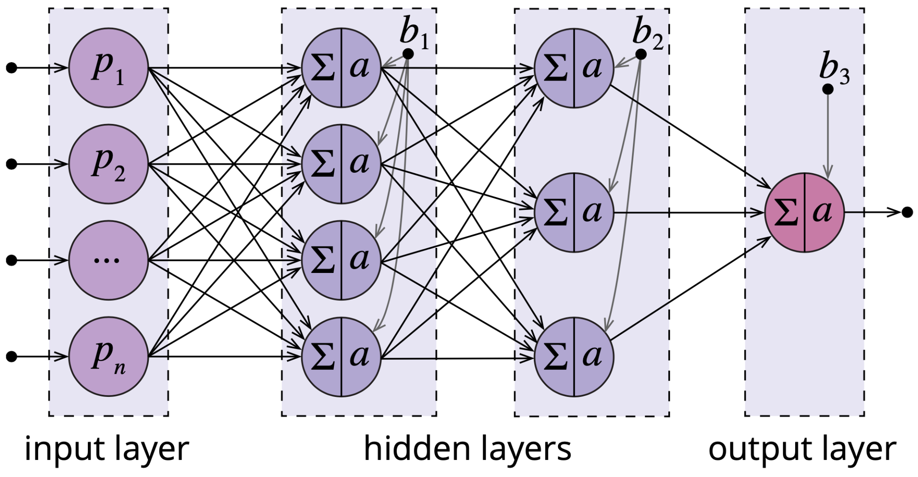
Multilayer perceptron (MLP)

Slide 62
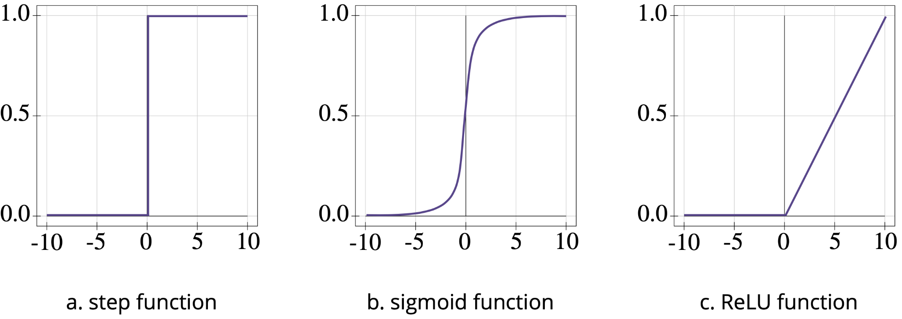
Activation functions

Slide 63
Deep learning
The number of nodes in a layer provides a measure of the width of a neural network
The depth of an ANN is defined by:
the number of layers in a feed-forward network
the length of the path from input to output in neural networks where feedback loops are possible
As “deep” ANN is generally taken to mean paths of three or more activating nodes from input to output (i.e., at a minimum a feed-forward MLP with two hidden layers)
Deep learning is particularly concerned with the construction, training, and use of deep neural networks

Slide 64
Convolutional neural networks (CNN)
Large images may contain millions of pixels, which would translate into billions of weights in a fully connected MLP
Such wide, fully connected MLPs are neither computationally efficient nor statistically efficient
CNNs increase both computational and statistical efficiency by restricting the connections between neural network nodes to those representing nearby localities
To achieve this, two new types of layers are introduced by CNNs:
a convolutional layer which combines values from pixels within a specified neighborhood using an image processing kernel
a pooling layer which combines values from nearby pixels using maximum, minimum, median, or other aggregate function of all the pixel values within a specified neighborhood

Slide 65
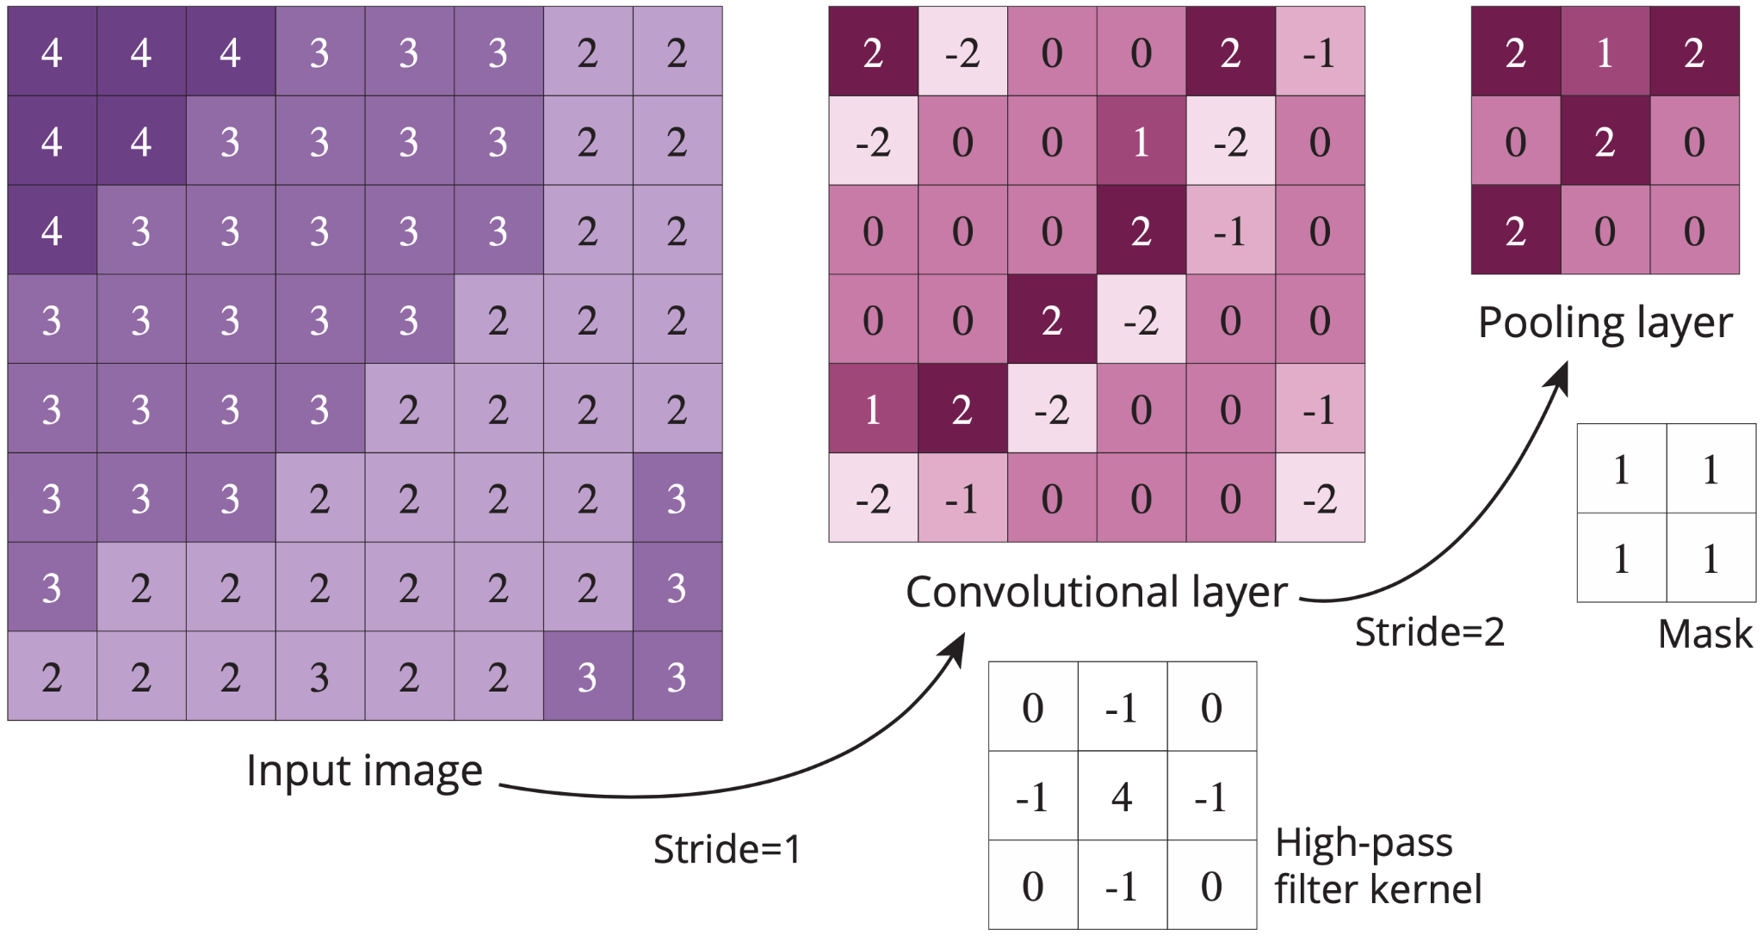
Convolutional neural networks

Slide 66
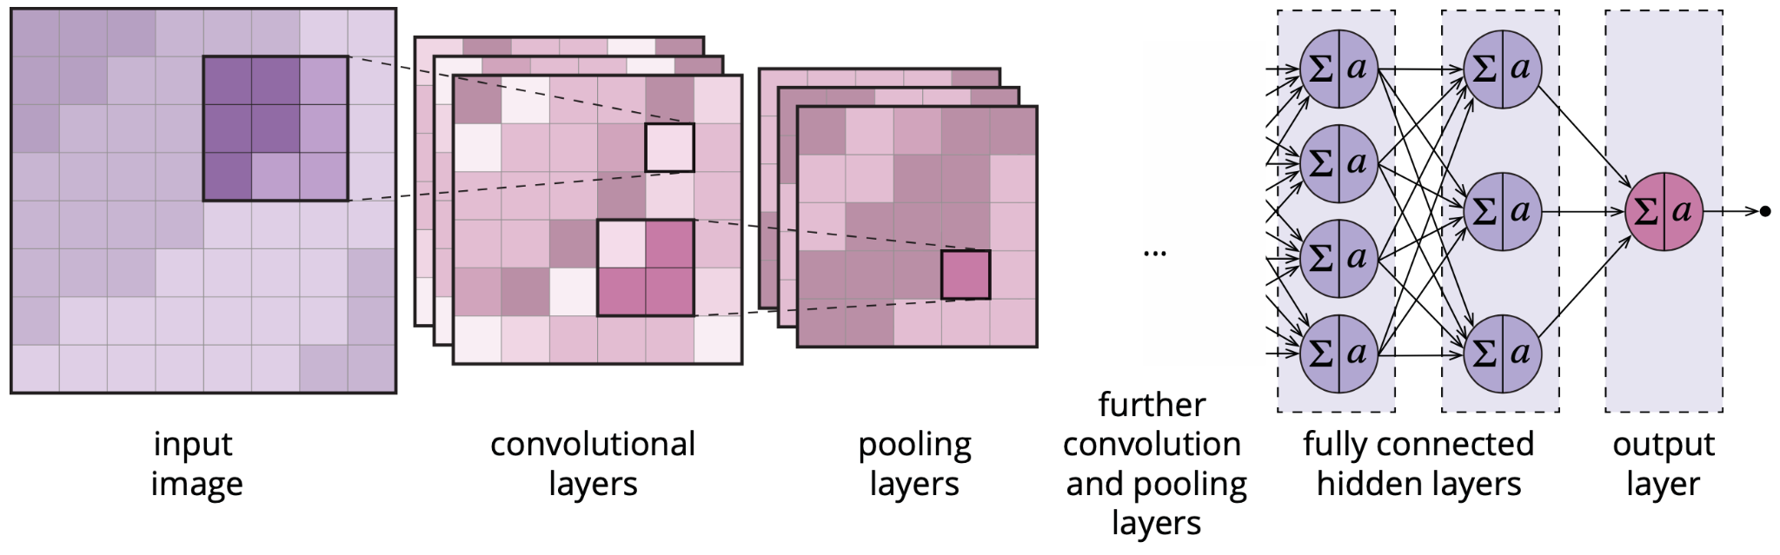
Convolutional neural networks

Slide 67
Graph and recurrent neural networks
Graph neural networks (GNNs) generalize the concept of the CNN to the arbitrary neighborhood structures found in abstract graphs
Three broad types of tasks tackled using GNNs:
node-level tasks, such as node classification and clustering
edge-level tasks, such as edge classification and link prediction
graph-level tasks, such as graph classification and graph matching
Recurrent neural networks (RNNs) contain feedback loops, where node outputs may connect back into the current or previous layers as well as forward towards the output
Looped connections equip the neural network with an analog of working memory, where previously processed training data may influence subsequent training steps
As a result, RNNs are especially well adapted for learning from data where the sequence or timing of data items is significant

Slide 68
Acknowledgments
Book website: http://gisacp.duckham.org All images: GIS: A Computing Perspective 3e, unless otherwise stated
Artwork: Lou Bloomer

